Slide 1

Rasa Certification Workshop
Mady Mantha, Juste Petraityte, Karen White

Slide 2
RASA CERTIFICATION WORKSHOP
Agenda
Part 1: Welcome and deep dive into Rasa
Welcome! 👋
Intro to Rasa
Conversation Design
Deep dive into NLU
Deep dive into dialogue policies
CDD and testing
Demo
Part 2: Adding custom actions, forms and improving your assistant using Rasa X
Reviewing the previous day 📚
Events and Slots
Custom actions and Forms
Improving the assistant using Rasa X
Connecting the assistant to the external messaging channels
What’s next

Slide 3



RASA CERTIFICATION WORKSHOP
The Rasa Team
Mady Mantha
Sr. Technical Evangelist
Juste Petraityte
Head of Developer Relations
Karen White
Developer Marketing Manager

Slide 4
RASA CERTIFICATION WORKSHOP
How to get help
Please ask your questions in the #workshop-help Slack channel
A note on time zones:
The Rasa team is based across the US and in Berlin. We’ll do our best to answer questions within team members’ working hours, but please keep in mind, some discussions may need to take place async rather than in real time.

Slide 5
Intro to Rasa

Slide 6
RASA CERTIFICATION WORKSHOP
Part 1 Roadmap
First half: talk
Second half: we’ll code together
Recap: talk, with some time for questions
*More info blablabla

Slide 7
5 LEVELS OF CONVERSATIONAL AI MATURITY MODEL
Contextual assistants are an important step on the journey to autonomous organizations
Last 10 years
Level 1:
Command-based
Most common today
Level 2:
“Chatbots” - FAQs
A few examples today
Level 3:
Contextual Assistants
In 2-5 years
Level 4:
Consultative Assistants
In 5-10 years
Level 5:
Adaptive Assistants
# Automation Use Cases

Slide 8




RASA OPEN SOURCE
Rasa Open Source
Natural Language Understanding
“I want to change my address”
Backend,
database, API, etc.
Connector Modules
E.g. Live Chat, App, Messenger
ML-based Dialogue Management
“What’s your new address?”
Response Selection

Slide 9

Conversational AI is not easy

Slide 10

Real conversations don’t follow the happy path

Slide 11


THE APPROACH
Build a minimum viable assistant with Rasa Open Source + improve it using Rasa X
Build minimum viable assistant
Improve by talking to the assistant
Improve using conversations with test users
Improve using conversations with real users
Quality of assistant
Rasa Open Source is an open source framework for natural language understanding, dialogue management, and integrations.
Rasa Open Source (Local)
Rasa X is a toolset used to improve a contextual assistant built using Rasa Open Source.
Rasa X (Server)

Slide 12
NLU & Dialogue Management

Slide 13




NLU Deep Dive
Natural Language Understanding (NLU)
Natural Language Understanding
How much did I spend at Starbucks last week?
Backend,
database, API, etc.
Connector Modules
ML-based Dialogue Management
~~~
Response Selection

Slide 14
NLU Deep Dive
Natural Language Understanding (NLU)
Goal: Extract structured information from messages
{...
"intent": {
"name": "search_transactions",
"confidence": 0.96
},
"entities": [
{
"entity": "vendor_name",
"value": "Starbucks",
...
}
]
}
How much did I spend at Starbucks last week?

Slide 15
NLU Deep Dive
Intents and Entities
Two of the most common and necessary types of information to extract from a message
Intent: What the user wants to achieve
How much did I spend at Starbucks last week?
Entity: Key piece of information

Slide 16
NLU DEEP DIVE
NLU Pipeline: Input and Output
Many components take the output of earlier components as input
Raw Text
Tokenizer
Tokens
Text Featurizer
Text Representation
Entity Extractor
Intent Classifier
Entities
Intent

Slide 17
NLU DEEP DIVE
NLU Pipeline: Example
“How much did I spend at Starbucks last week?”
[how, much, did, i, spend,
at, starbucks, last, week]
[(0, 421) 1
(1, 48) 2
: :
(2, 90) 1
(2, 150) 1]
Tokenizer
Text Featurizer
Entity Extractor
Intent Classifier
vendor_name: starbucks
search_transactions

Slide 18
NLU DEEP DIVE
“Text Representation”
Raw Text
How do words turn into numbers?
[(0, 421) 1
(1, 48) 2
: :
(2, 90) 1
(2, 150) 1]
Tokenizer
Tokens
Text Featurizer
Text Representation
Entity Extractor
Intent Classifier
Entities
Intent

Slide 19
NLU DEEP DIVE
Intent Classification & Entity Extraction
“How much did I spend at Starbucks last week?”
[how,much,did,i,spend,at,starbucks,last,week]
[(0, 421) 1
(1, 48) 2
: :
(2, 90) 1
(2, 150) 1]
Tokenizer
Text Featurizer
Text Representation
Entity Extractor
Intent Classifier
vendor_name: starbucks
search_transactions

Slide 20
NLU DEEP DIVE
Text Representation: Word Vectors
“Judge a Word by the Company it Keeps” — John R. Firth
“... sleep on a bed...”
“...sleep in a bed?”
“...sleep on a mattress...”
“...mattress to sleep on…”
sleep?
bed
mattress
These would be two of many dimensions!

Slide 21
NLU DEEP DIVE
Text Representation: How models use word vectors
Non-sequence model:
One feature vector per input (whole message)
Order of words not captured
Sequence model:
One feature vector per token (word) & feature vector for whole message
Word order captured

Slide 22
Configuration Files

Slide 23
Livecoding
Let’s start coding!
Let’s use a sandbox branch instead of the master branch you cloned yesterday. Make sure you are inside the financial-demo folder:
cd financial-demo
Fetch the remote branches:
git fetch origin
Checkout the sandbox branch named “workshop_day_2_sandbox”:
git checkout -b workshop_day_2_sandbox origin/workshop_day_2_sandbox

Slide 24
Core Deep Dive
Domain
Defines the “world” of your assistant - what it knows, can understand, and can do
intents:
…
entities:
…
slots:
…
actions:
…
responses:
…
session_config:
…
What your bot can understand
What your bot can remember
What your bot can do (and say)
What your bot can say (and display)
What your bot considers a new conversation

Slide 25
LIVE CODING: MINIMUM VIABLE ASSISTANT
Project setup: Files
__init__.py | an empty file that helps python find your actions
actions.py | code for your custom actions
config.yml | configuration of your NLU and dialogue models
credentials.yml | details for connecting to other services
data/nlu.md | your NLU training data
data/stories.md | your stories
domain.yml | your assistant’s domain
endpoints.yml | details for connecting to channels like fb messenger
models/<timestamp>.tar.gz | your initial model

Slide 26
NLU Deep Dive
NLU Pipeline
Defines how a user message is processed & what information is extracted
language: "en"
pipeline:
name: "Whitespacetokenizer"
name: "ConveRTFeaturizer"
name: "RegexFeaturizer"
name: "LexicalSyntacticFeaturizer"
name: "CountVectorsFeaturizer"
Components

Slide 27
NLU Deep Dive
NLU Pipeline: Components
Built-in component types:
Tokenizers
Word Vector Sources
Text Featurizers
Entity Extractors
Intent Classifiers
Response Selectors
You can also add custom components for e.g.
Sentiment analysis
Spell checking

Slide 28
NLU DEEP DIVE
DIETClassifier: Intent Classification & Entity Extraction
The Short Story
DIETClassifier
Intent
search_transactions
Entities
vendor name: starbucks
Dense Features
(Pretrained Embeddings)
Sparse Features
“How much did I spend at Starbucks last week?”

Slide 29
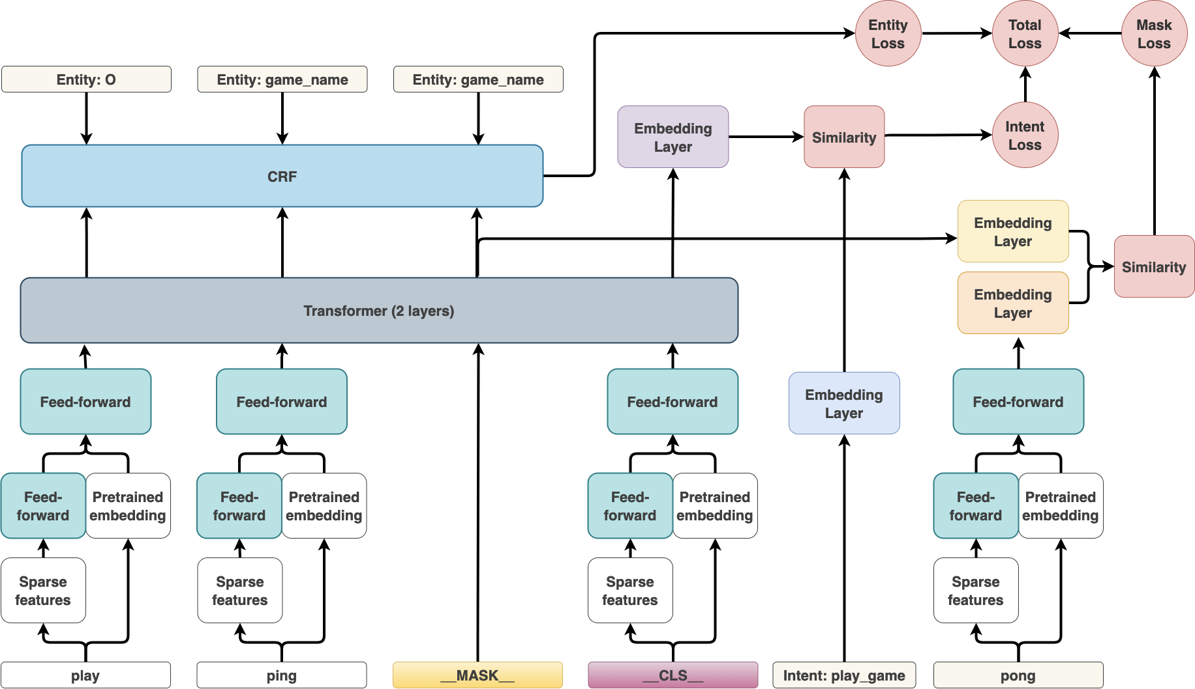
NLU DEEP DIVE
DIET: Intent Classification & Entity Extraction
entities
intent

Slide 30
NLU DEEP DIVE
Feature: Customize What Features Go In!
sparse features
in pipeline
BERT/GloVe/pretrained and continuous features

Slide 31
NLU DEEP DIVE
Entity Extraction: Other options
Possible Approaches:
Rule-based entity extraction
Direct structured prediction of entity based on sentence context
DIETClassifier
MitieEntityExtractor
SpacyEntityExtractor
DucklingHTTPExtractor
EntitySynonymMapper
Trained on your data
Pretrained
Predefined, rule-based
Modifies extracted entities

Slide 32
Livecoding
Let’s create some intents and entities!

Slide 33

Core Deep Dive: Policies
Policies
Decide which action to take at every step in the conversation
Each policy predicts an action with some probability. This is called core confidence.
Interpreter
“I want to know how much I spent at Starbucks last week”
1
2
Message In
Tracker
3
Policy
Message Out
“You spent $12 at Starbucks”
6
5
Action
4

Slide 34
Core Deep Dive: Policies
Rule Based Policies
MemoizationPolicy: Memorizes your stories
Makes predictions based on your max_history value
AugmentedMemoizationPolicy: Memorizes your stories with a twist
As above, but if no match is found, it will forget certain events until a match is found
FormPolicy: Fills required slots
Asks for information until all required slots are filled
MappingPolicy: Intents trigger actions
Will execute the specified action regardless of context unless superseded by another policy
FallbackPolicy: Failing gracefully
If model confidence is below a certain value, it will send the user a “fallback message”, e.g. “Sorry, I didn’t understand you”
TwoStageFallbackPolicy: Failing (more) gracefully
Attempts to disambiguate the user’s intent before sending a fallback message

Slide 35
Core Deep Dive: Policies
Machine Learning Based Policies
These policies should be used in conjunction with rule-based policies
KerasPolicy: Uses a standard LSTM to predict the next action
Learns the patterns of your stories
Good for handling stories that don’t exactly match your training data
TED Policy: Uses Attention to Handle Uncooperative Dialogue
Requires fewer story examples of uncooperative user dialogue
e.g. users who go off on tangents instead of providing the requested information
Effectively “ignores” irrelevant parts of the dialogue

Slide 36
Core Deep Dive: Policies
Multiple Policies
The policy with the highest confidence wins.
If the confidence of two policies is equal, the policy with the highest priority wins.
Policy priorities
(higher numbers = higher priority)
5. FormPolicy
4. FallbackPolicy, TwoStageFallbackPolicy
3. MemoizationPolicy, AugmentedMemoizationPolicy
2. MappingPolicy
1. EmbeddingPolicy, KerasPolicy, TED
Rule-based policies have higher priority than ML-based policies

Slide 37
Conversation Design

Slide 38


Core Deep Dive
Initially: Conversations as simple question / answer pairs
What can I help you with today?
I just moved
What is your new address?
It’s 120 King St in New York City.

Slide 39
Core Deep Dive
Real conversations are more complex: Rely on context
What can I help you with today?
I just moved
What is your new address?
It’s 120 King St
Which city do you live in?
in New York City

Slide 40
Conversation Design
Scope Conversation
How to get started with conversation design
The assistant’s purpose
Leverage the knowledge of domain experts
Common search queries
FAQs and wikis

Slide 41
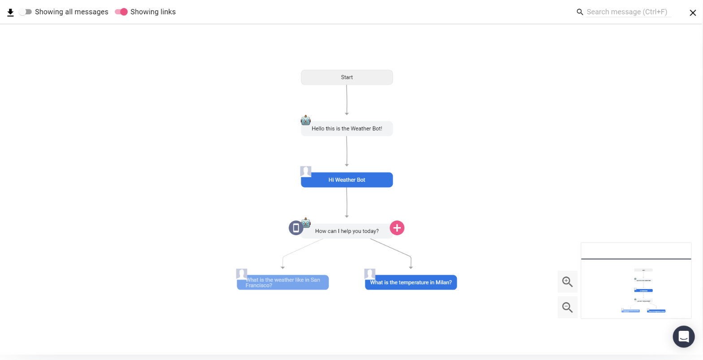
Conversation Design
Scope Conversation
Source: Botsociety

Slide 42
Livecoding
Let’s create some stories together!
Check account balance
Search transactions

Slide 43
Core Deep Dive
The importance of context
Shall we mail letters to the same address too?
Previous Action
Context: Mailing to an address
Which one do you have on file at the moment?
NLU
Dialogue Management
Response Generator
We currently send letters to...
Intent
clarification_question
90.5% probability
vector = (0, 11, 26, … , 1)
Action
show_mailing_address
92.5% probability
vector =(2 , 212, 90, … , 5)

Slide 44
Core Deep Dive
The importance of context
Shall I also update your credit card details?
Previous Action
Context: Update Billing Info
Which one do you have on file at the moment?
NLU
Dialogue Management
Response Generator
We currently charge this credit card...
Intent
clarification_question
90.5% probability
vector = (0, 11, 26, … , 1)
Action
show_payment_info
89.3% probability
vector =(4 , 170, 90, … , 5)

Slide 45
Core Deep Dive
Dialogue Handling
previous
Action
How much did I spend at Starbucks last week?
State
next
Action
Intent
SVM
Recurrent NN
...
Entities
You spent $12 at Starbucks last week!
Thanks.
updated
State
after next
Action

Slide 46
NLU Deep Dive
NLU: Output to Dialogue Management
Natural Language Understanding
entity: vendor_name
value: Starbucks
…
name: search_transactions
confidence: 0.96
Backend,
database, API, etc.
Connector Modules
ML-based Dialogue Management
Natural Language Generation

Slide 47
Core Deep Dive
Dialogue Management (Core)
Natural Language Understanding
My new address is 222 Broadway NYC.
Backend,
database, API, etc.
Connector Modules
ML-based Dialogue Management
~~~
Response Selection

Slide 48
Training Data

Slide 49
Training Data for NLU and Dialogue Management
Machine learning models require training data that the models can generalize from
NLU needs data in the form of examples for intents
Dialogue management model needs data in the form of stories
## intent:bot_challenge
- are you a bot?
- are you a human?
- am I talking to a bot?
- am I talking to a human?
## intent:i_like_food
- I like [apples](food)
- my friend likes [oranges](food)
- I'm a fan of [pears](food)
- do you like [coffee](food)
## new to rasa at start
* how_to_get_started{"user_type": "new"}
- action_set_onboarding
- slot{"onboarding": true}
- utter_getstarted_new
- utter_built_bot_before
* deny
- utter_explain_rasa_components
- utter_rasa_components_details
- utter_ask_explain_nlucorex

Slide 50
Rasa Deep Dive
Rasa Open Source Reviewed
Natural Language Understanding
“How much did I spend at Starbucks last week?”
Backend,
database, API, etc.
Connector Modules
E.g. Live Chat, App, Messenger
ML-based Dialogue Management
“You spent $12 at Starbucks!”
Response Selection

Slide 51
Deep dive into DIET, TED, and some testing!

Slide 52
Core Deep Dive
Domain
Defines the “world” of your assistant - what it knows, can understand, and can do
intents:
…
entities:
…
slots:
…
actions:
…
responses:
…
session_config:
…
What your bot can understand
What your bot can remember
What your bot can do (and say)
What your bot can say (and display)
What your bot considers a new conversation

Slide 53
LIVE CODING: MINIMUM VIABLE ASSISTANT
Project setup: Files
__init__.py | an empty file that helps python find your actions
actions.py | code for your custom actions
config.yml | configuration of your NLU and dialogue models
credentials.yml | details for connecting to other services
data/nlu.md | your NLU training data
data/stories.md | your stories
domain.yml | your assistant’s domain
endpoints.yml | details for connecting to channels like fb messenger
models/<timestamp>.tar.gz | your initial model

Slide 54
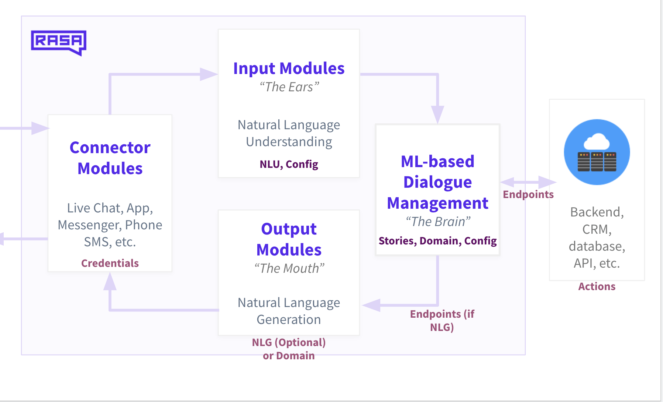
Rasa Certification Workshop
In other words

Slide 55

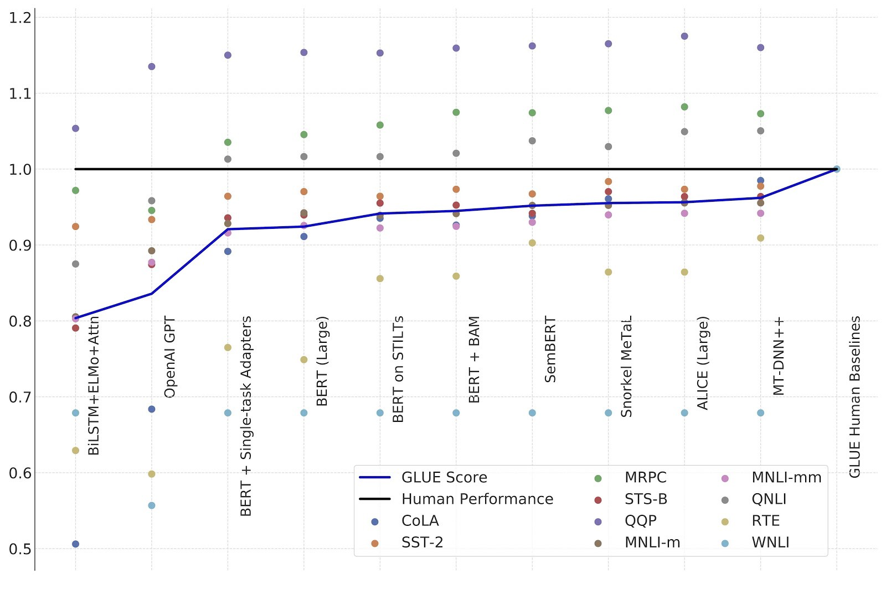
Glue is out, SuperGlue is in
@madymantha

Slide 56
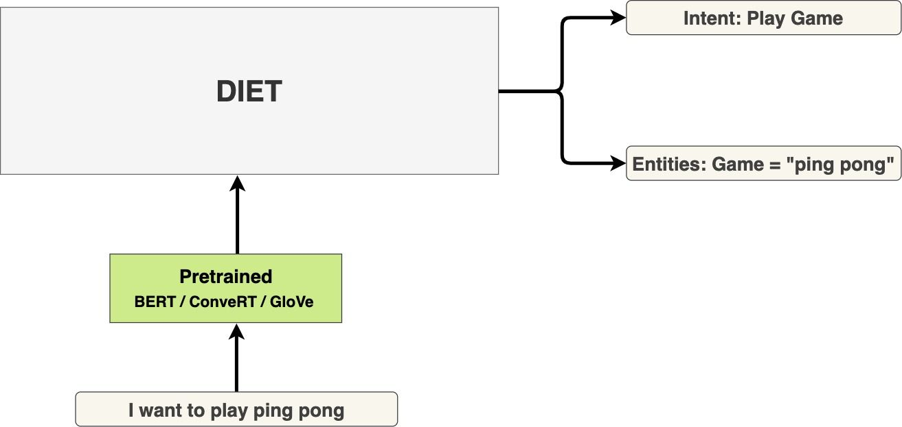
NLU Deep Dive
DIET is our new neural network architecture for NLU
What is DIET?
New state of the art neural network architecture for NLU
Predicts intents and entities together
Plug and play pretrained language models

Slide 57
NLU DEEP DIVE
Feature: Customize what features go in!
sparse features
in pipeline
BERT/GloVe/pretrained and continuous features
@madymantha

Slide 58
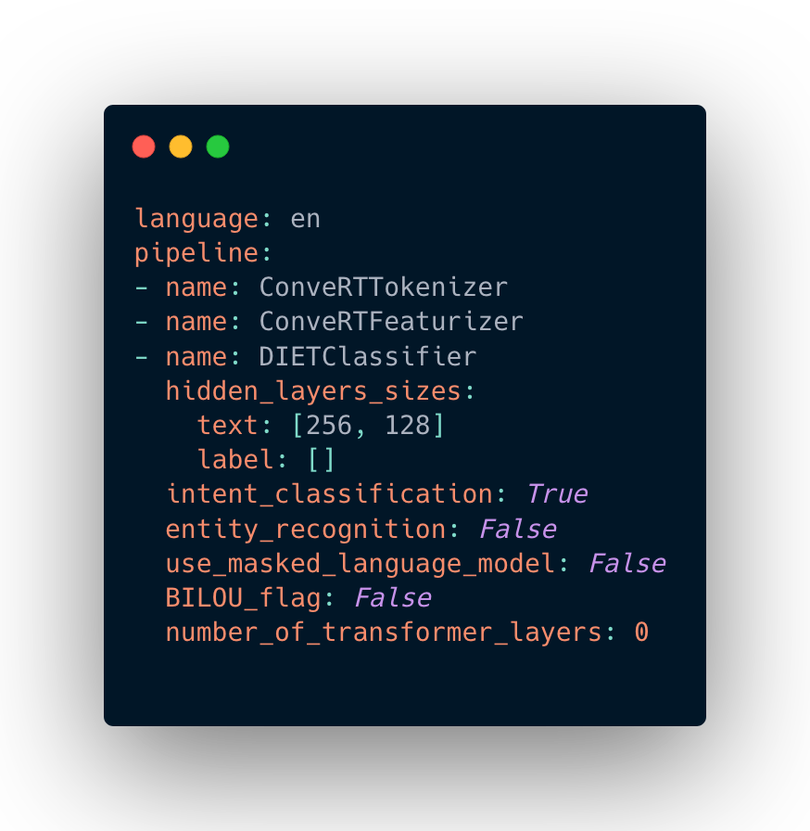
How to use DIET in your Rasa project
Here’s an example config.yml
Before the DIET model, you can specify any featurizer.
In our experiments, we use:
Sparse features (aka no pre-trained model)
GloVe (word vectors)
BERT (large language model)
ConveRT (pre-trained encoder for conversations)
@madymantha

Slide 59
Experiments on the NLU-benchmark dataset
Repo is on github
Domain: human-robot interaction (smart home setting)
64 different intents
54 different entity types
~26k labelled examples
Previous state of the art:
HERMIT NLU (Vanzo, Bastianelli, and Lemon @ SIGdial 2019)
uses ELMo embeddings
@madymantha

Slide 60
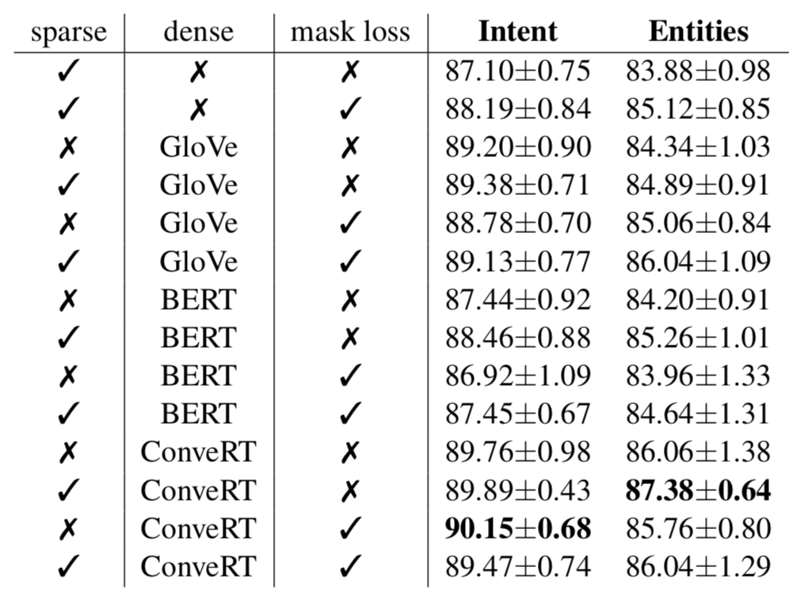
Result 1: DIET outperforms SotA even without any pretrained embeddings
Previous state of the art: intent: 87.55 entities: 84.74
@madymantha

Slide 61
Result 2: GloVe embeddings perform better than BERT
@madymantha

Slide 62
Result 3: ConveRT embeddings perform best on the NLU-benchmark dataset
@madymantha

Slide 63
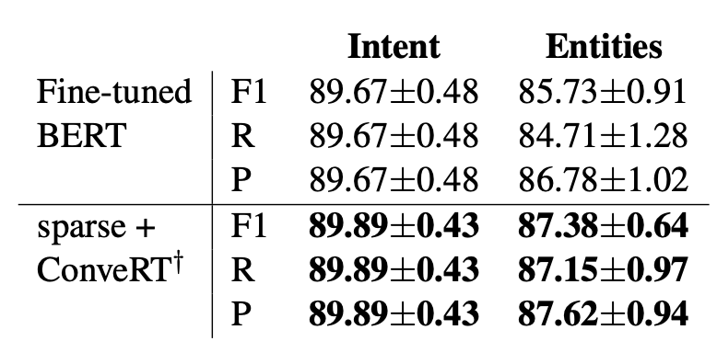
Result 4: DIET outperforms fine-tuning BERT
@madymantha

Slide 64
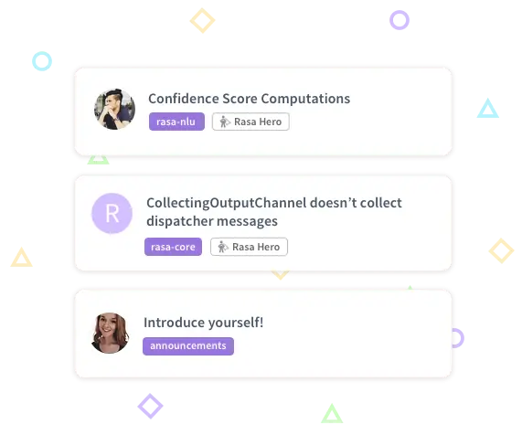
Which featurizer is best depends on your dataset, so try different ones!
We don’t believe in “one size fits all” machine learning
We aim to provide sensible defaults and suggestions
BUT even more important that these models are easy to customize
Share your results and compare notes with 8000+ developers at forum.rasa.com
@madymantha

Slide 65
Transformer Embedding Dialogue policy (TED)

Slide 66
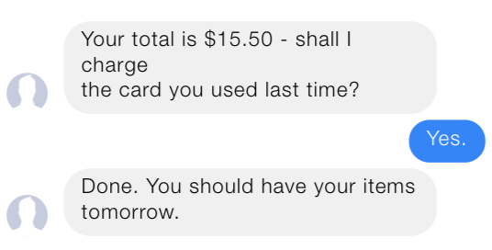
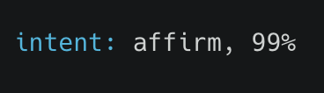
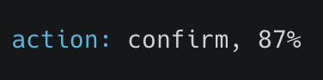
NLU Deep Dive
Conversational AI requires NLU and Dialogue management
@madymantha

Slide 67
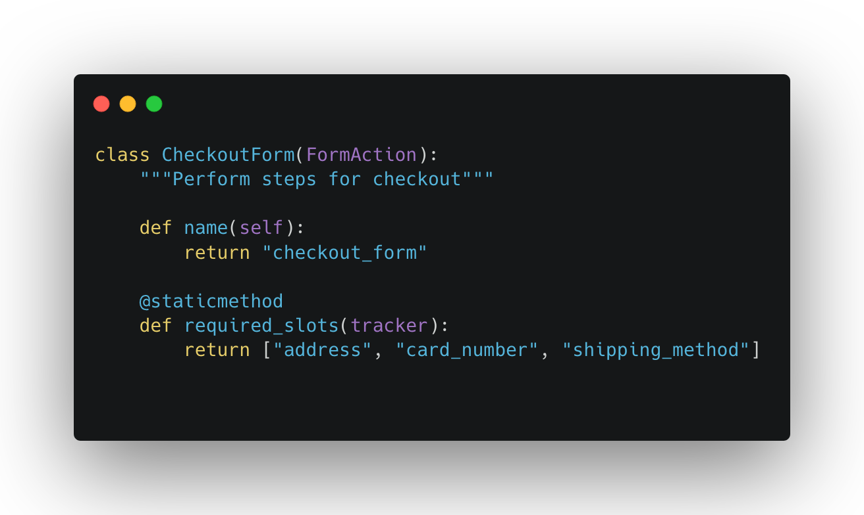
Happy paths are already solved
@madymantha

Slide 68
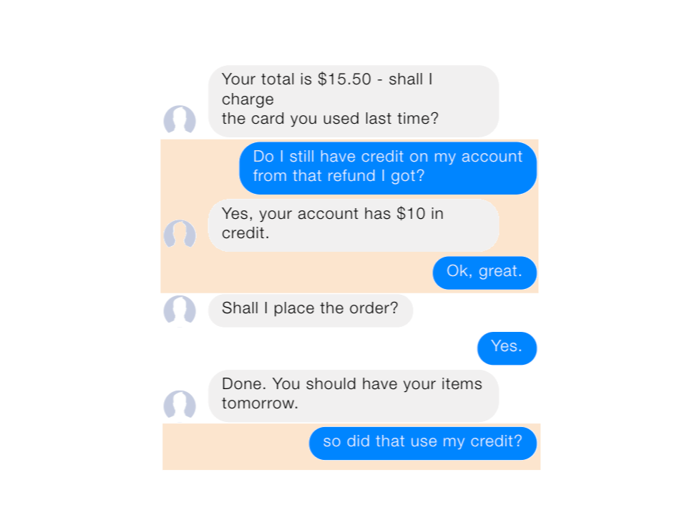
You can’t predict user behavior
@madymantha

Slide 69
Users will interject and loop back to earlier topics
@madymantha

Slide 70
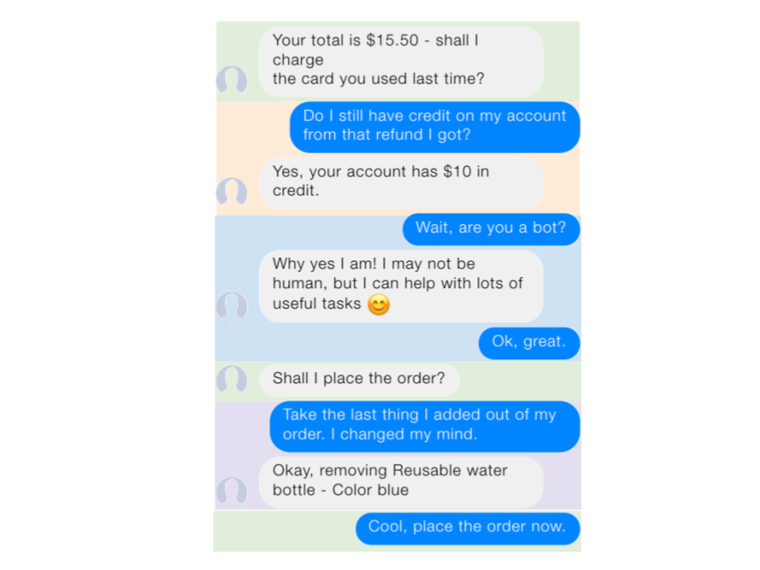
Real conversations don’t follow the happy path
@madymantha

Slide 71
People typically use a recurrent neural net (RNN) to model dialogue
W
h₁
W
y₁
W
W
W
h₂
y₂
W
W
W
y₃
h₃
@madymantha

Slide 72
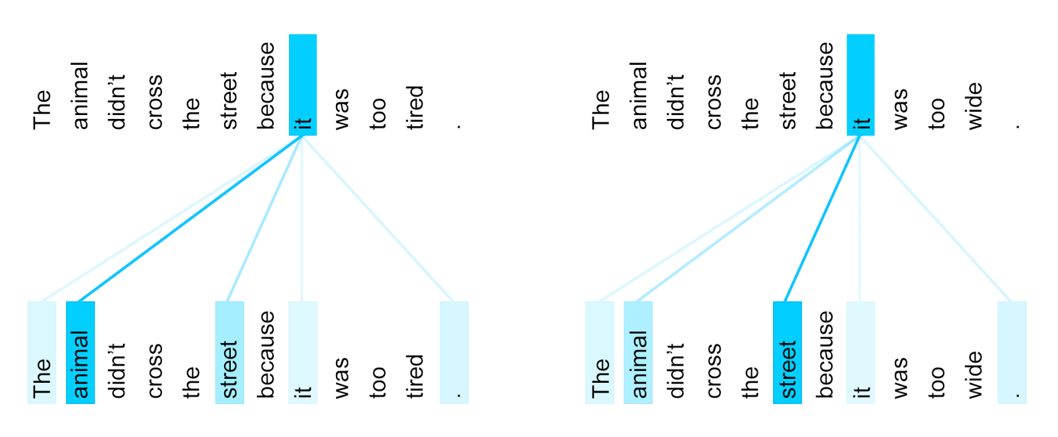
But not all input should be treated equally
https://ai.googleblog.com/2017/08/transformer-novel-neural-network.html
@madymantha

Slide 73
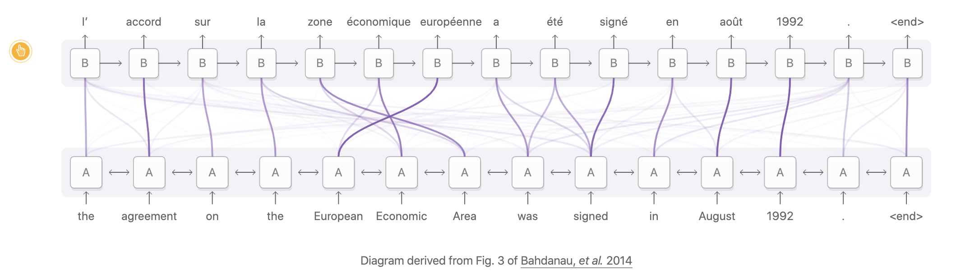
Transformers (AKA self-attention) are now state of the art for many tasks
https://distill.pub/2016/augmented-rnns/
@madymantha

Slide 74
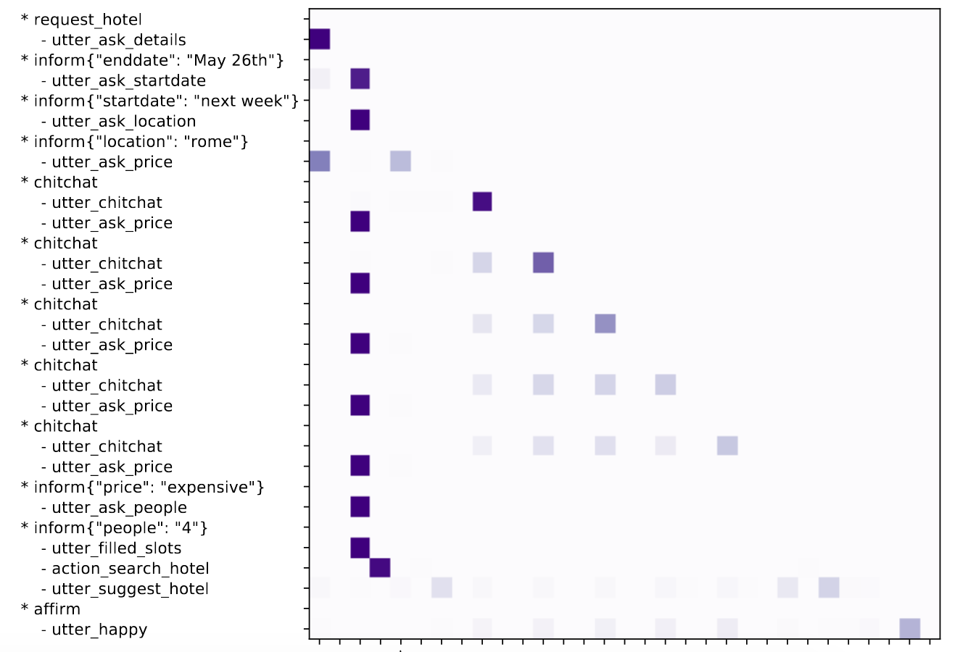
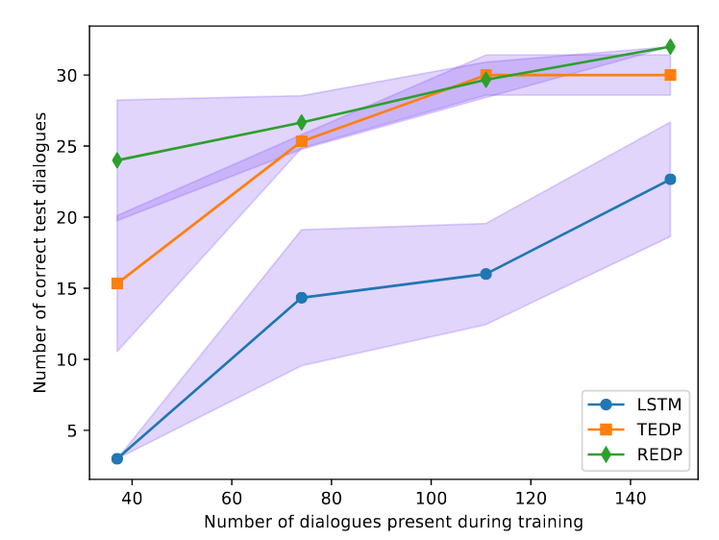
We found out that the Transformer Embedding Dialogue policy can untangle sub-dialogues
paper
@madymantha

Slide 75
Development Stages
Conversation Driven Development (CDD)
The challenge
When developing assistants, it’s impossible to anticipate all of the things your users might say.
The approach
A user-centric process: listening to your users and using those insights to improve your AI assistant.
Blog post: Conversation-Driven Development

Slide 76
Conversation Driven Development
Share
Review
Annotate
Test
Track
Fix
1
2
3
4
5
6
Rasa X

Slide 77
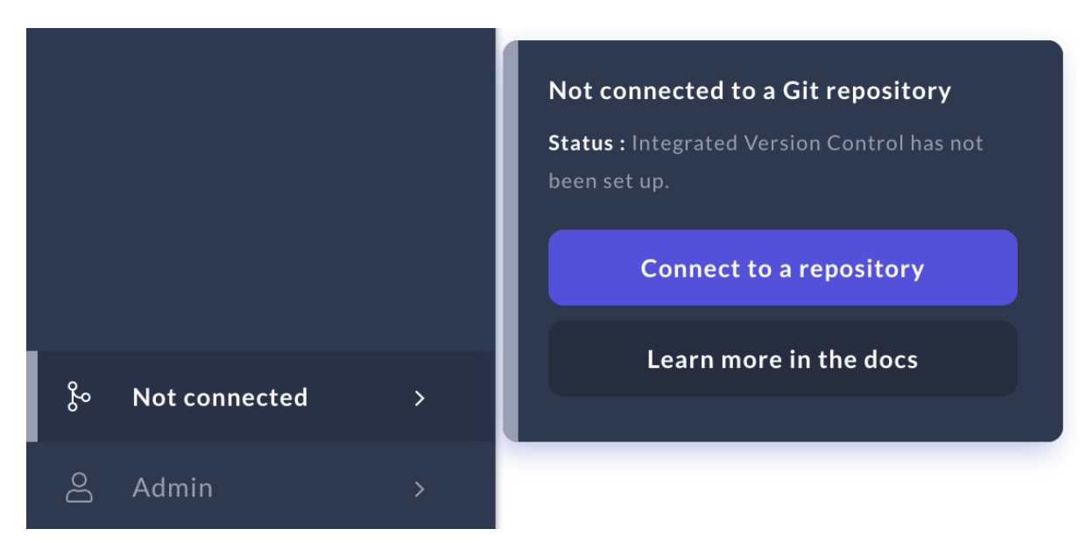
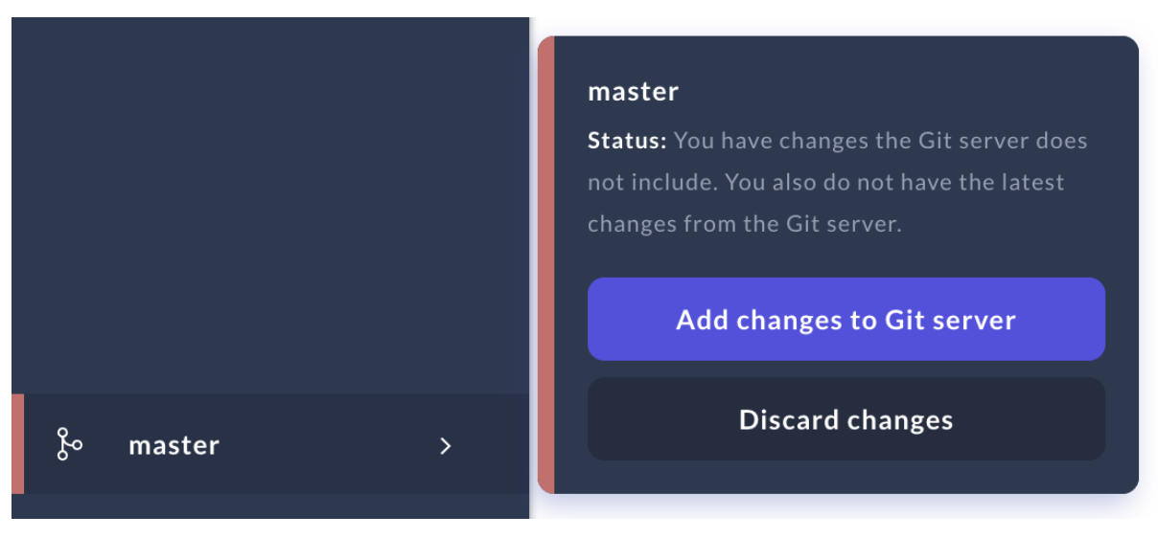
RASA TOOLS AND PRODUCTS
Successful production-ready bots follow engineering best practices

Slide 78
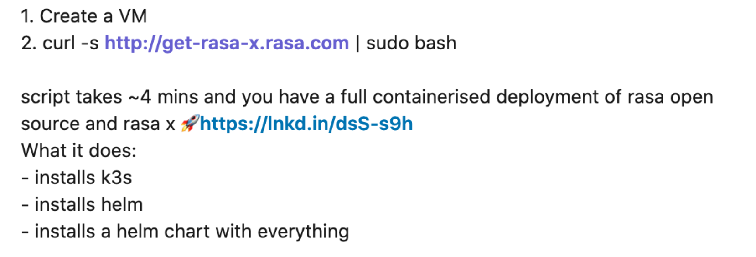
TIME TO VALUE
From zero to production-ready deployment in under 5 minutes
@madymantha

Slide 79
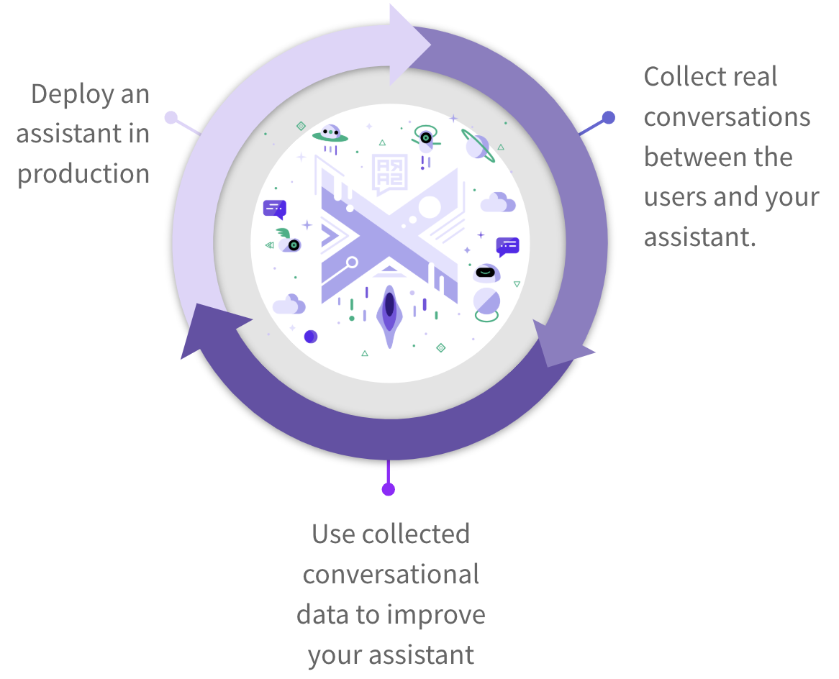

THE APPROACH
Continually improve your assistant using Rasa X
Ensure your new assistant passes tests using continuous integration (CI) and redeploy it to users using continuous deployment (CD)
Collect conversations between users and your assistant
Review conversations and improve your assistant based on what you learn

Slide 80
Testing

Slide 81
Testing
Use the Rasa CLI to test your assistant
End to End Evaluation
NLU Evaluation
Core Evaluation
Run through test conversations to make sure that both NLU and Core make correct predictions.
Split data into a test set or estimate how well your model generalizes using cross-validation.
Evaluate your trained model on a set of test stories and generate a confusion matrix.
$ rasa test
$ rasa test nlu -u data/nlu.md --config config.yml --cross-validation
$ rasa test core --stories test_stories.md --out results

Slide 82
Interactive Learning: Talk to your bot yourself
RASA DEEP DIVE
Correct your bot’s predictions as you go
Save conversations as training stories or E2E stories

Slide 83
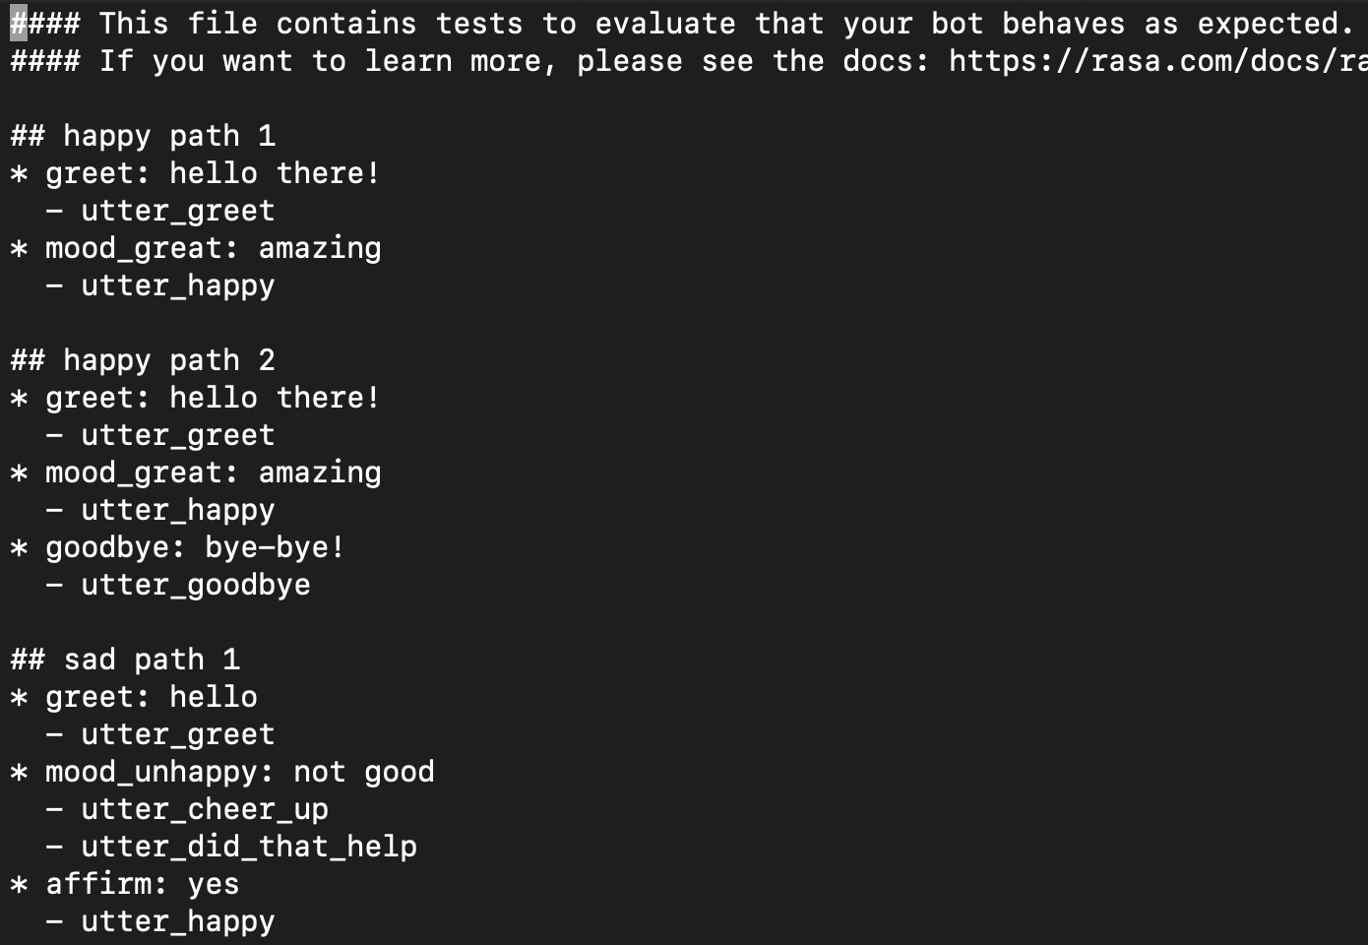
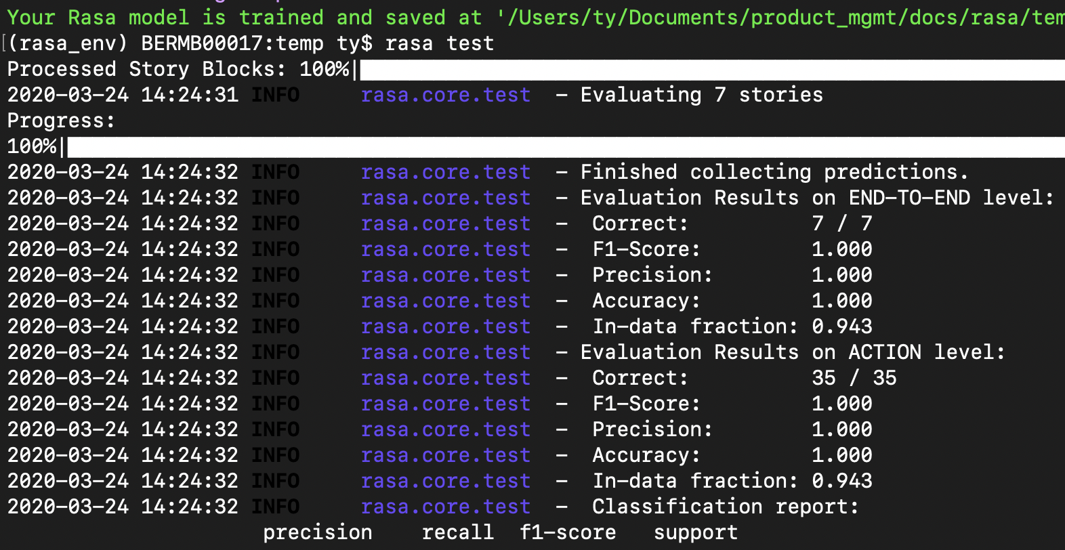
Testing
Run `rasa test` locally when building a minimum viable assistant
Test your model after training to make development more productive and reliable

Slide 84
Adding custom actions and implementing forms

Slide 85
RASA CERTIFICATION WORKSHOP
Agenda
Day 1: Welcome and deep dive into Rasa
Welcome! 👋
Intro to Rasa
Conversation Design
Deep dive into NLU
Deep dive into dialogue policies
CDD and testing
Demo
Day 2: Adding custom actions, forms and improving your assistant using Rasa X
Events and Slots
Custom actions and Forms
Improving the assistant using Rasa X
Connecting the assistant to the external messaging channels
What’s next

Slide 86
RASA CERTIFICATION WORKSHOP
Day 2: Roadmap for the first half of the day
Part 1:
Rasa events and slots: talk and coding together
Custom actions: talk and coding together
Short break 🧁
Part 2:
Forms: talk and coding together
Recap and Q&A

Slide 87
RASA OPEN SOURCE
Rasa Open Source
Natural Language Understanding
“I want to change my address”
Backend,
database, API, etc.
Connector Modules
E.g. Live Chat, App, Messenger
ML-based Dialogue Management
“What’s your new address?”
Response Selection

Slide 88
LIVE CODING: MINIMUM VIABLE ASSISTANT
Project setup: Files
__init__.py | an empty file that helps python find your actions
actions.py | code for your custom actions
config.yml | configuration of your NLU and Core models
credentials.yml | details for connecting to other services
data/nlu.md | your NLU training data
data/stories.md | your stories
domain.yml | your assistant’s domain
endpoints.yml | details for connecting to channels like fb messenger
models/<timestamp>.tar.gz | your initial model

Slide 89
Rasa events and slots

Slide 90
Core Deep Dive
Events
Internally, conversations are represented as a sequence of events.
Some events are automatically tracked
Events
Story
UserUttered
SlotSet
SlotSet
BotUttered
UserUttered
Restarted
## new to rasa at start
* how_to_get_started{"user_type": "new"}
- action_set_onboarding
- slot{"onboarding": true}
- utter_getstarted_new
* restart
- action_restart

Slide 91
Core Deep Dive
Tracker
Trackers maintain the state of a dialogue between the assistant and the user.
It keeps track of events, slots, session info etc.
{
"sender_id": "default",
"slots": {
"user_type": "new",
"onboarding": true},
"latest_message": {...},
"events": [
...
{"event": "action",
"name": "action_set_onboarding",
"policy": "MemoizationPolicy",
"confidence": 0.92},
...
{"event": "user",
"text": "\/restart",...},
...
]
}
Session info
Slots
Events:
...
SlotSet
...
UserUttered
...

Slide 92
Core Deep Dive
Slots
Your bot’s memory
Hi, my name is Tom
Hi
Hello! How can I help?
Hello! How can I help?
I would like to check my
account balance
I would like to check my
account balance
Sure. Can you tell me your surname?
What is your name?

Slide 93
Core Deep Dive
Slots
Your bot’s memory
Can store:
user-provided info
info from the outside world
Can be set by:
NLU (from extracted entities, or buttons)
Custom Actions
Can be configured to affect or not affect the dialogue progression

Slide 94
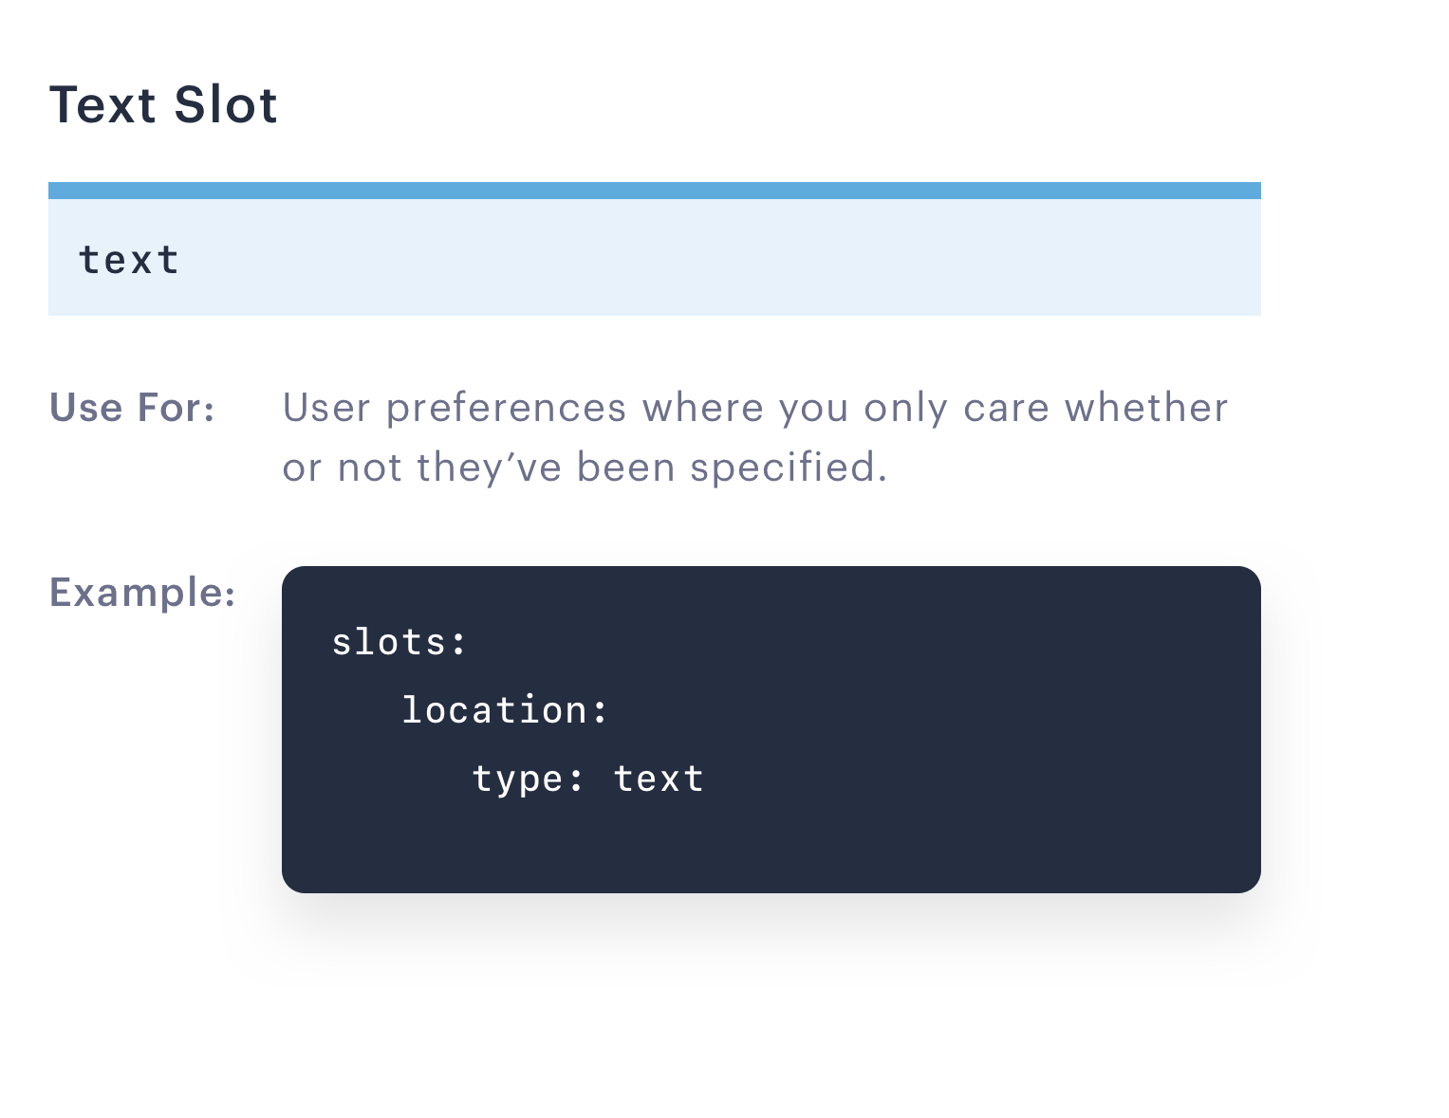
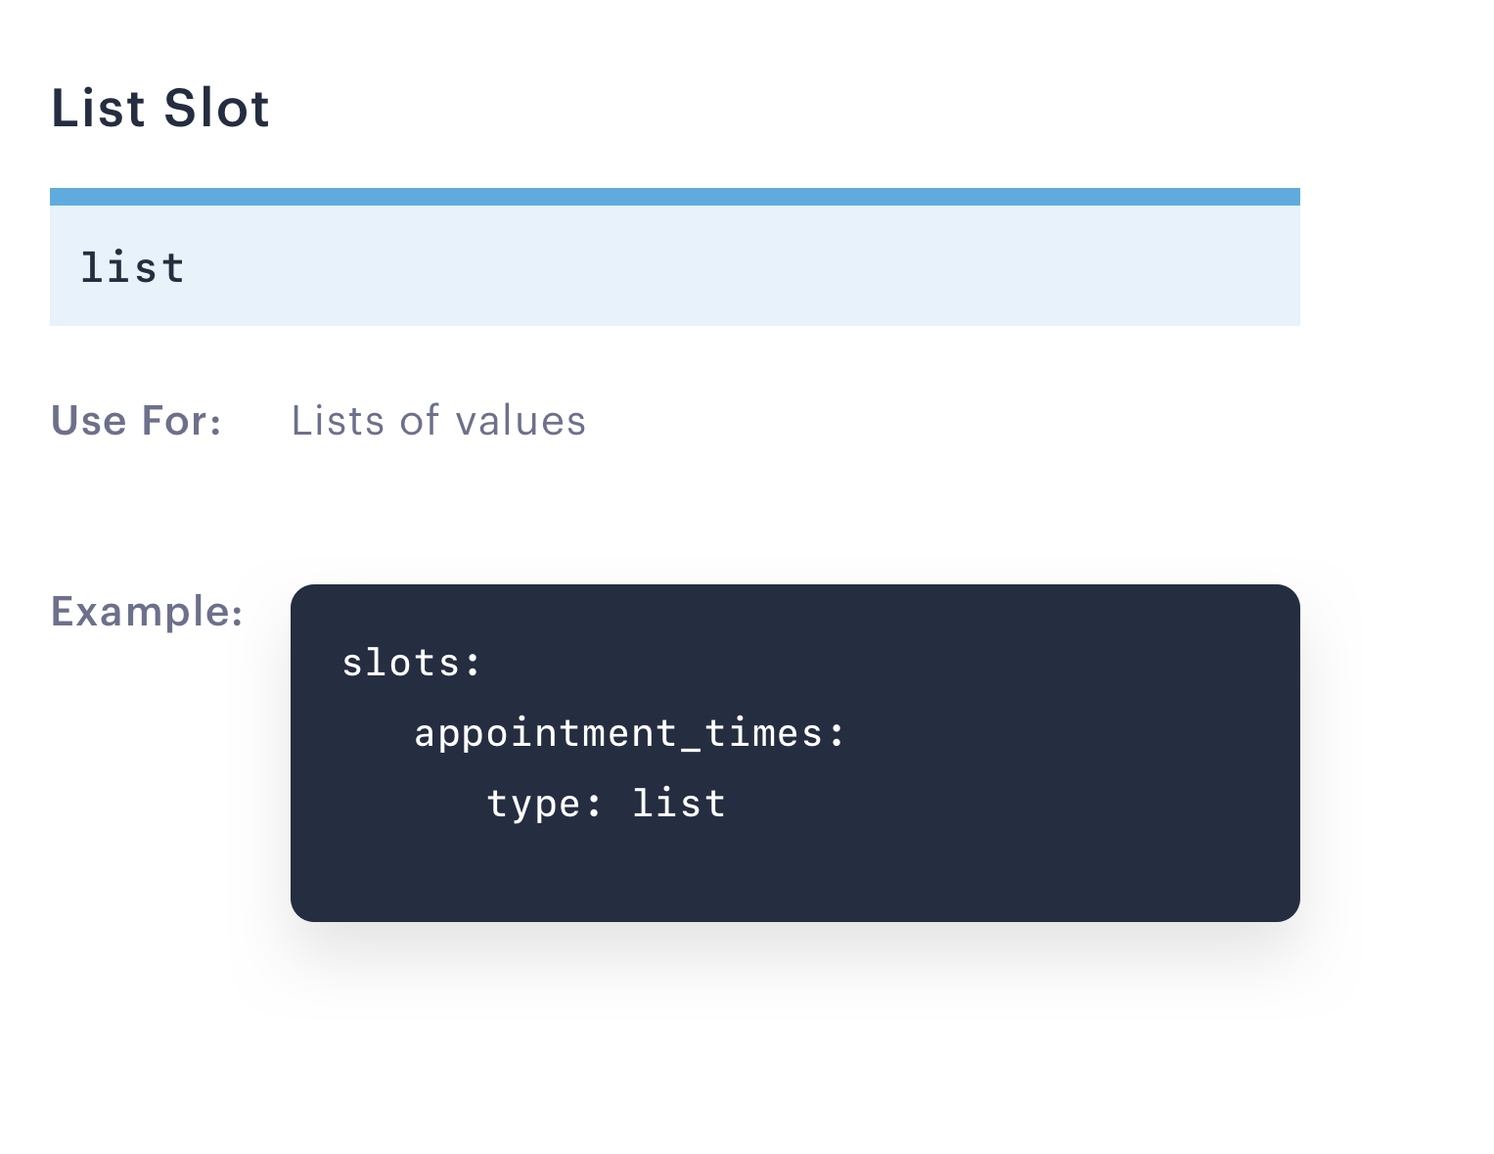
Core Deep Dive
Slots types
Text and List slots influence conversation path based on whether it is set or not.
“I am based in London”
“Are there available appointments on Monday or Wednesday this week?”

Slide 95
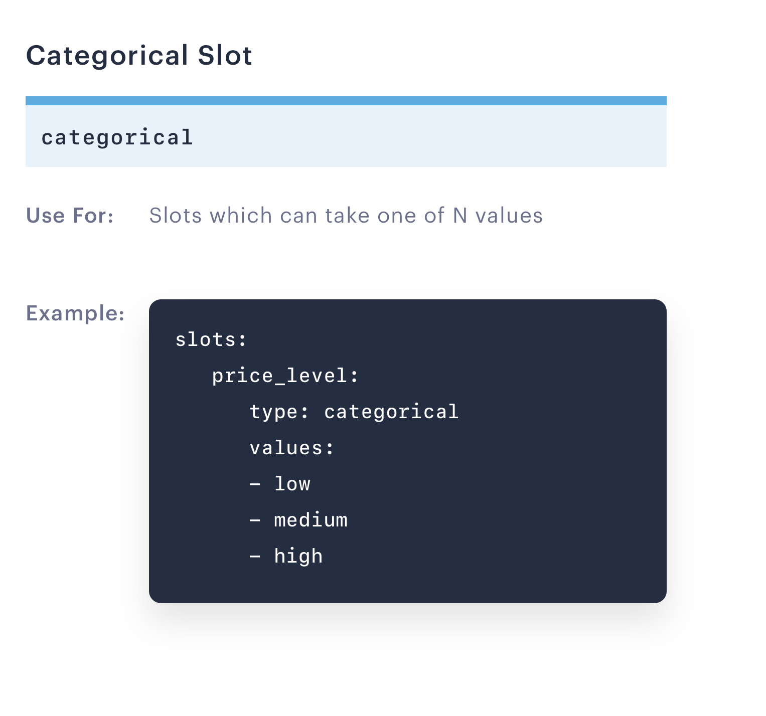
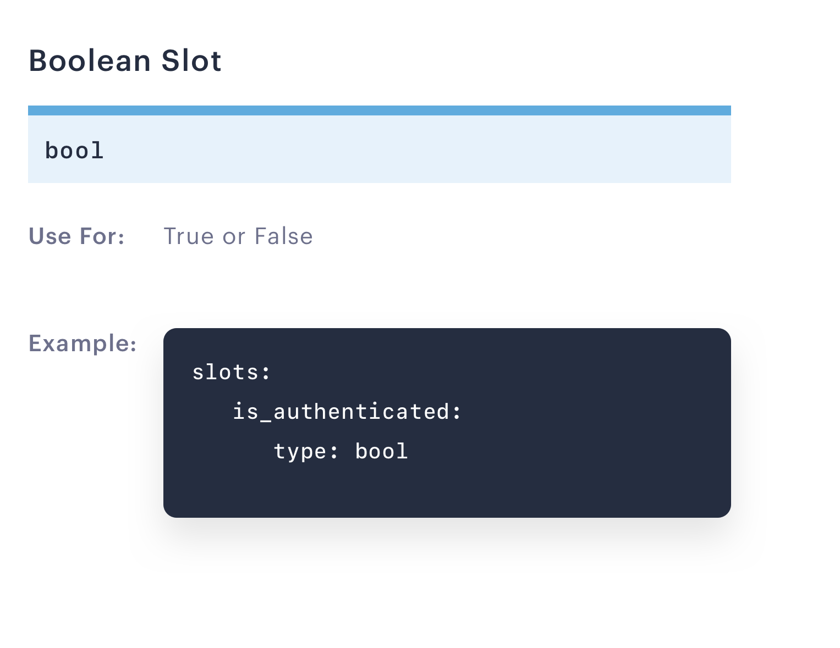
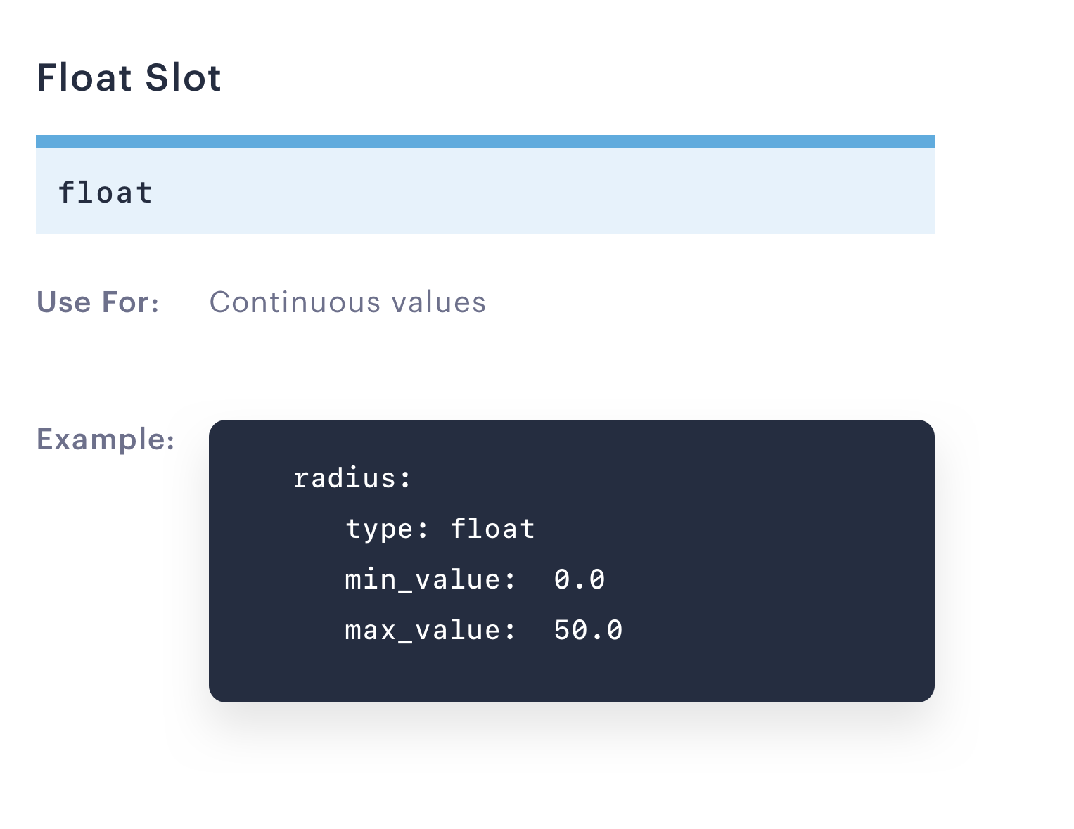
Core Deep Dive
Slots types
Categorical, Boolean and Float slots influence conversation path based on the value of the slot.
“I am looking for a restaurant in a low price range.”
“Find me a restaurant within 2 mile radius.”

Slide 96
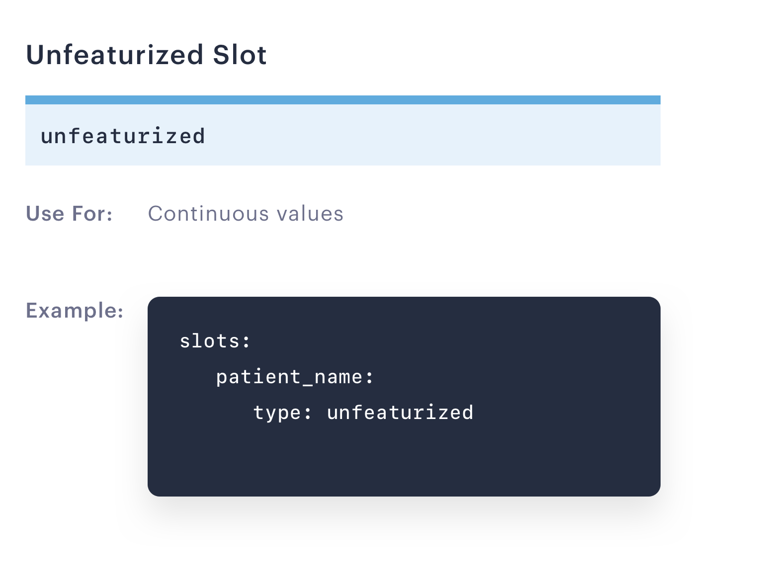
Core Deep Dive
Slots types
Unfeaturized slots don’t have any influence on the dialogue.
“My name is Sarah.”

Slide 97
Core Deep Dive
Slots
There are a few different ways how slots can be set
Slots set from NLU
## intent:search_transactions
- how much did I spend at [Target](vendor_name) this week?
- what is my typical spending at [Amazon](vendor_name)?

Slide 98
Core Deep Dive
Slots
There are a few different ways slots can be set
Slots set by clicking buttons
utter_ask_transfer_form_confirm:
text: “Would you like to transfer $100 to Tom?”
buttons:
title: Yes
payload: /affirm
title: No, cancel the transaction
payload: /deny
Would you like to transfer $100 to Tom?
Yes
No, cancel the transaction

Slide 99
Core Deep Dive
Slots
There are a few different ways how slots can be set
Slots set by custom actions
## account balance story
* check_account_balance
- action_account_balance
- slot{"account_balance": 1000}
- slot{"amount_transferred": None}

Slide 100
Livecoding
Let’s define the slots for our Financial Bot assistant!
Let’s use a sandbox branch for today’s exercise. First, make sure your are in a financial bot directory:
cd financial-demo
Pull the latest updates pushed to the repo:
git pull
Checkout the sandbox branch named “workshop_day_2”:
git checkout workshop_day_2

Slide 101
Custom actions

Slide 102
Core Deep Dive
Custom Actions: Connecting to the outside world
Natural Language Understanding
My new address is 222 Broadway NYC.
Backend,
database, API, etc.
Connector Modules
ML-based Dialogue Management
~~~
Natural Language Generation
Response Selection

Slide 103
Core Deep Dive
Actions
Functions your bot runs in response to user input.
Four different action types:
Utterance actions: `utter_`
send a specific message to the user
specified in `responses` section of the domain
Retrieval actions: `respond_`
send a message selected by a retrieval model
Custom actions: `action_`
run arbitrary code and send any number of messages (or none).
return events
Default actions:
built-in implementations available but can be overridden
E.g. action_listen, action_restart, action_default_fallback

Slide 104
Core Deep Dive
Custom Actions: The Action Server
Custom action code is run by a webserver called the action server
How custom actions get run:
When a custom action is predicted, Rasa will call the endpoint to your action server
The action server:
runs the code for your custom action
[optionally] returns information to modify the dialogue state
How to create an action server:
You can create an action server in any language you want!
You can use the Rasa-SDK for easy development in Python

Slide 105
Core Deep Dive
Custom Actions: Examples
Custom actions can do whatever you want them to! e.g.
Send multiple messages
Query a database
Make an API call to another service
Return events e.g.
Set a slot
e.g. based on a database query)
Force a follow up action
force a specific action to be executed next
Revert a user utterance
I.e. remove a user utterance from the tracker

Slide 106
Core Deep Dive
Custom Action Example: Query a Database
using the Rasa SDK
class ActionCheckAddress(Action):
def name(self) -> Text:
return "action_check_address"
def run(self,
dispatcher: CollectingDispatcher,
tracker: Tracker,
domain: Dict[Text, Any]) -> List[Dict[Text, Any]]:
idnum = tracker.get_slot('person_id')
q = "SELECT Address FROM Customers \
\WHERE CustomerID=1;'{0}'".format(idnum)
result = db.query(q)
return [SlotSet(
"address",
result if result is not None else "NotOnFile")]
“Should I also update your mailing address?”
“What do you have on file?”

Slide 107
Let’s Code
Let’s implement a custom for our financial assistant
We will implement a custom action which will allow users to check their account balance:
Hello
Hello! How can I help?
I would like to check my
account balance
Your account balance is $10.

Slide 108
Forms

Slide 109
Core Deep Dive
Forms
Rasa Forms allow you to describe all happy paths with a single story
## Happy path 1:
U: I would like to make a money transfer
B: Towards which credit card would you like to make a payment?
U: Towards my justice bank credit card
B: How much do you want to pay?
U: $100
B: The transaction has been scheduled.
## pay credit card happy path
* pay_cc
- cc_payment_form
- form{"name": "cc_payment_form"}
- form{"name": null}
## Happy path 2:
U: I would like to make a 100$ money transfer
B: Towards which credit card would you like to make a payment?
U: Towards my justice bank credit card
B: The transaction has been scheduled.

Slide 110
Core Deep Dive
Forms
The structure of the form
## pay credit card happy path
* greet
- utter_greet
* pay_cc
- cc_payment_form
- form{"name": "cc_payment_form"}
- form{"name": null}
User input
Form action
Form activated
Form deactivated

Slide 111
Core Deep Dive
Forms
FormAction is a custom action which allows you to set the required slots and determine the behaviour of the form
The main components of the form action:
name - defines the name of the form actions
def name(self) -> Text:
" " "Unique identifier of the form" " "
return "cc_payment_form"

Slide 112
Core Deep Dive
Forms
FormAction is a custom action which allows you to set the required slots and determine the behaviour of the form
The main components of the form action:
required slots - sets the list of required slots
def required_slots(tracker: Tracker) -> List[Text]:
" " "A list of required slots to fill in" " "
return [“credit_card”, “amount_of_money”]

Slide 113
Core Deep Dive
Forms
FormAction is a custom action which allows you to set the required slots and determine the behaviour of the form
The main components of the form action:
submit - defines the output of the form action once all slots are filled in
def submit(self, args) -> List[Dict]:
" " "Defines what the form has to do after all slots are filled in" " "
dispatcher.utter_message(“The payment is confirmed”)
return [AllSlotsReset()]

Slide 114
Core Deep Dive
Forms: Custom slot mappings
The slot mappings define how to extract slot values from user inputs.
With slot mappings you can define how certain slots can be extracted from:
Entities
Intents
Support free text input
Support yes/no inputs
def slot_mappings(self) -> List[Text, Union[Dict, List[Dict]]]:
" " "Defines what the form has to do after all slots are filled in" " "
return {
“confirm”: [
self.from_intent(value:True, intent=”affirm”),
self.from_intent(value:False, intent=”deny”)
]
}

Slide 115
Core Deep Dive
Forms: Validating user input
Validate method in form action allows you to check the value of the slot against a set of values.
I would like to make a $100 payment.
validate
“Minimum balance”: 85
“Current balance”: 550
slot: amout_of_money

Slide 116
Core Deep Dive
Forms
Custom Form Action
Custom Form Action allows you to add new methods to a regular FormAction.
class CustomFormAction(FormAction):
def name(self):
return “”
def custom_method(self, args):
...
return

Slide 117
Core Deep Dive
Forms
Handling unhappy paths
Users are not always cooperative - they can change their mind or interrupt the form.
Create stories to handle the interruptions:
## pay credit card unhappy path
* pay_cc
- cc_payment_form
- form{"name": "cc_payment_form"}
* chitchat
- utter_chitchat
- cc_payment_form
- form{"name": null}

Slide 118
Core Deep Dive
Forms
Handling unhappy paths
Users are not always cooperative - they can change their mind or interrupt the form.
Use action action_deactivate_form to handle the situation where users decide not to proceed with the form:
## chitchat
* pay_cc
- cc_payment_form
- form{"name": "cc_payment_form"}
* stop
- utter_ask_continue
* deny
- action_deactivate_form
- form{"name": null}

Slide 119
Core Deep Dive
Forms
How this affect domain and policy configuration?
Domain
Policy configuration
forms:
cc_payment_form
policies:
name: FormPolicy

Slide 120
Let’s Code
Let’s implement a for paying out a credit card
We will implement a form which will enable our assistant to collect necessary information to pay a credit card:
Hello
Hello! How can I help?
I would like to pay my credit card
Towards which account would you like to make a payment?
Iron bank
How much would you like to transfer?
$1000
When would you like the transaction to be made?
Today
Do you want to schedule a $1000 transfer to iron bank for today?
Yes

Slide 121
Part 4: Messaging Channels, Conversation Driven Development, and Rasa X

Slide 122
Agenda
Theme for this section: Connecting with your users
Conversation Driven Development
Combining user input and software engineering best practices at every stage of the development cycle
Conversations = training data
Rasa X
A tool for Conversation Driven Development
Launching Rasa X locally
Reviewing conversations
Messaging Channels
Live coding: connecting Telegram
Review

Slide 123
Conversation Driven Development

Slide 124
WHY CDD
CDD captures the lessons we’ve learned as a community
If you’ve built conversational AI before, you know that:
It is very hard.
Building a prototype is not the hard part.
The hard parts all show up when you want to go from a prototype to something you’d want to ship.
Conversation-Driven Development should:
Help all of us build better conversational AI.
Save newcomers from having to learn this the hard way.

Slide 125

What is the opposite of conversation driven development?
Developing your assistant for months in isolation before testing it with users
Only looking at top-level metrics, not conversations themselves
Autogenerating training data that doesn’t reflect ways users really interact
Pushing changes to production without running tests

Slide 126
Conversation-Driven Development
Share
Review
Annotate
Test
Track
Fix
1
2
3
4
5
6

Slide 127


Share
Users will always surprise you.
So get some test users to try your prototype as early as possible.
Projects that ship without a bunch of test users are bound to fall down in production.

Slide 128
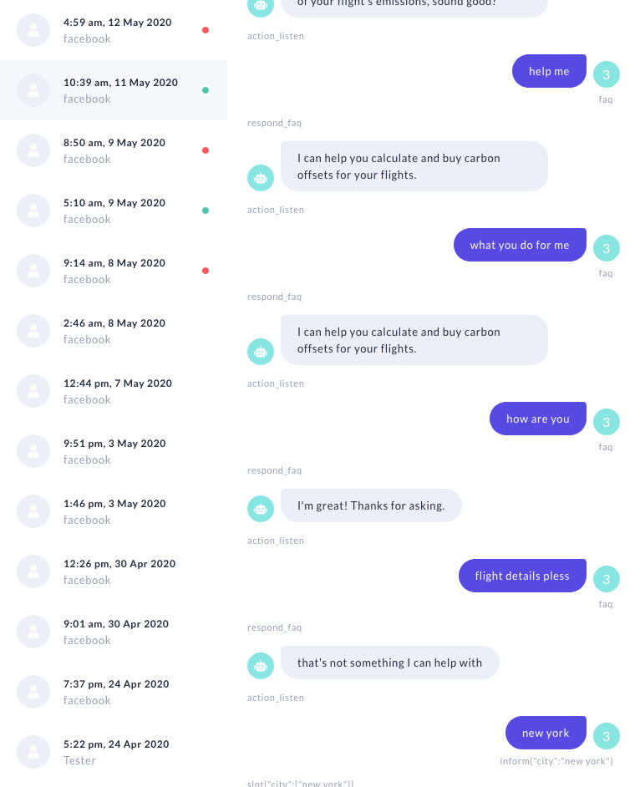
Review
At every stage of a project, it is worth reading what users are saying.
Avoid getting caught up in metrics right away. Conversations are valuable data.

Slide 129
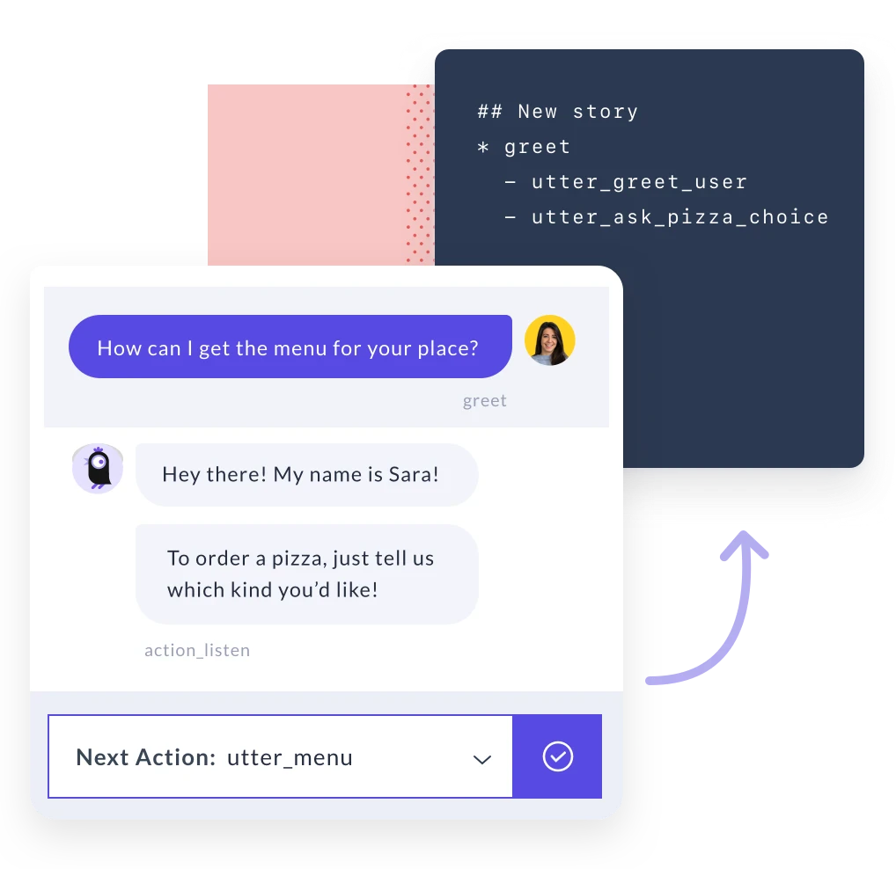


Annotate
Using a script to generate synthetic training data
Turning real messages into training examples

Slide 130
Rasa X Tour
Real Conversations > Synthetic Data
During development, training data is created by:
Writing down hypothetical conversations and training examples
Studying existing chat transcripts or knowledge bases
Consulting subject matter experts
That’s a great start, but all of those scenarios are based on human:human conversations.
Human:bot conversations have different patterns - users talk to a bot differently than they do a human
The best training data is generated from the assistant’s actual conversations

Slide 131
Quality of data, by source
Human + bot conversations
1
Human + human conversations
2
Manufactured data
3
Quality
Documentation, FAQs
4

Slide 132
By the time you go to production, most of your training data should come from human:bot interactions
Human + bot conversations
1
Human + human conversations
2
Proportion
Manufactured data
3
Documentation, FAQs
4

Slide 133
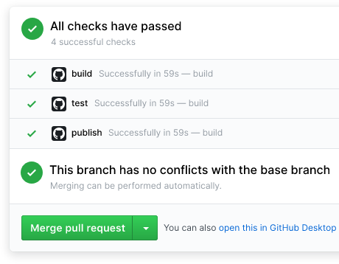
Test
Professional teams don’t ship applications without tests.
Use whole conversations as end-to-end tests
Run them on a continuous integration (CI) server.

Slide 134
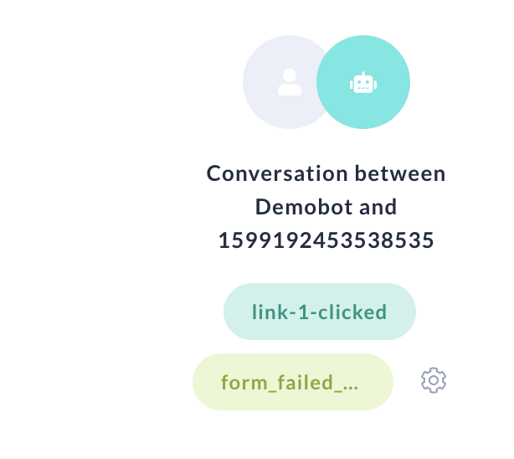
Prototype
Track
Use proxy measures to track which conversations are successful and which ones failed.
‘Negative’ signals are useful too, e.g. users not getting back in touch with support.

Slide 135

Prototype
Fix
Study conversations that went smoothly and ones that failed.
Successful conversations can become new tests 🎉
Fix issues by annotating more data and/or fixing your code 🔧

Slide 136
CDD in practice

Slide 137
PROCESS
It’s not a linear process: you’ll find yourself jumping between these actions
share
review
annotate
test
track
fix

Slide 138

TEAM
Some actions require software skills, others a deep understanding of the user
Image credit: Freepik

Slide 139
CDD for teams
Track
Review
Share
Test
Annotate
Fix
Product
Design
Development
Product Managers
Innovation and Business Leaders
UX Designers
Conversation Designers
Content Creators
Engineers
Data Scientists
Annotators

Slide 140
Rasa X is a tool to help teams do CDD

Slide 141
Rasa X Tour
Rasa X turns conversations into training data
Review Conversations
See what users are saying to your bot
Manage Training Data
Annotate training data and add new examples
🤖
💬
Messaging channels
Share your bot
Conversations
Rasa X
Conversations
Review 👁️‍🗨️ Annotate ✏️ Improve 💪

Slide 142
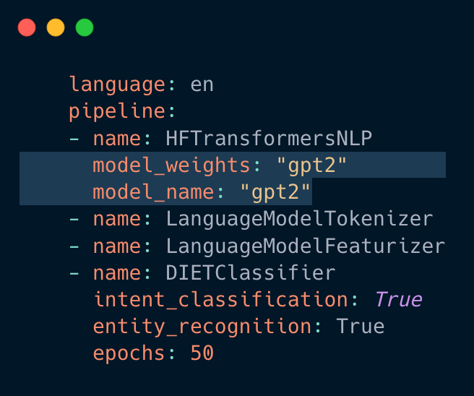
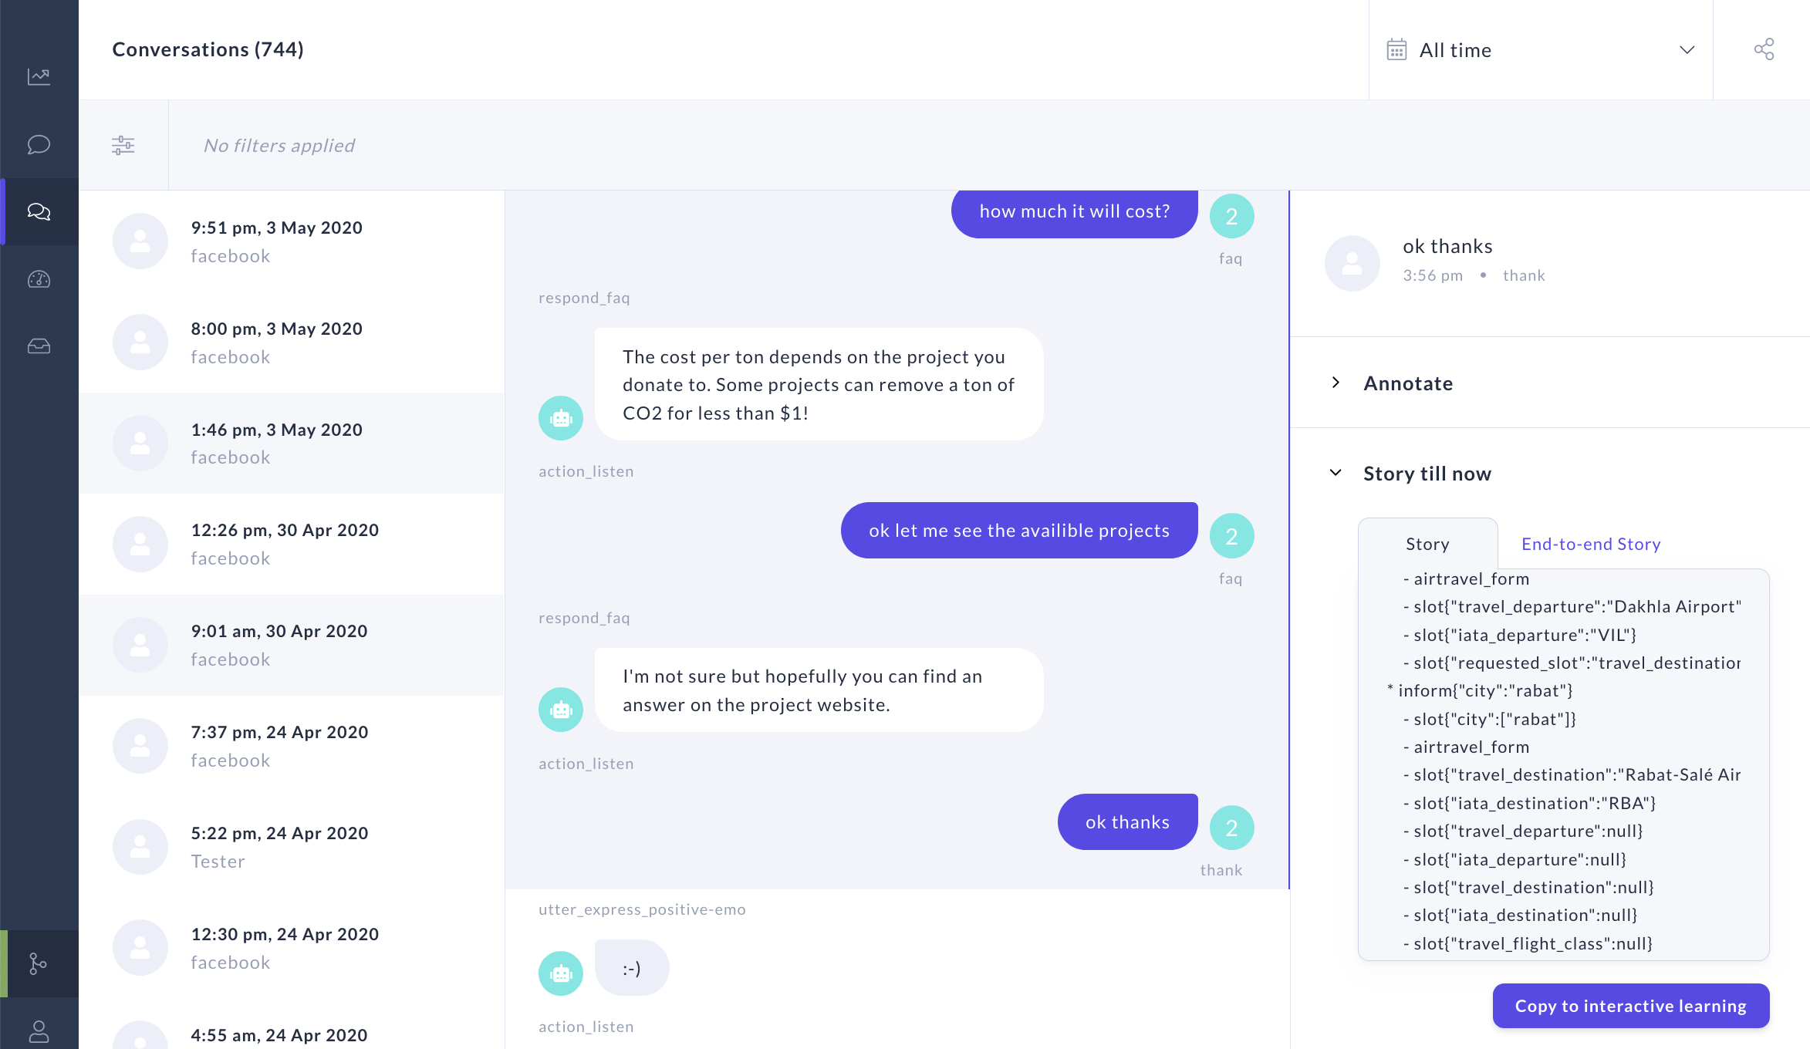
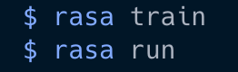
PRODUCT
Rasa X layers on top of Rasa Open Source
Rasa Open Source: Framework for building AI assistants
Rasa X: Tool for Conversation-Driven Development
≈≈

Slide 143
Rasa X Local mode vs Server mode
Local Mode:
Great for initial testing, familiarizing yourself with Rasa X
Conversations get saved to a local database
Server Mode:
Great for serving your bot and collecting conversations from many testers or users, 24/7
Production-ready & scalable
Deploys Rasa X (and your assistant) using Docker Compose or Kubernetes
Conversations get saved to a production database
Includes a Git integration (integrated version control)

Slide 144
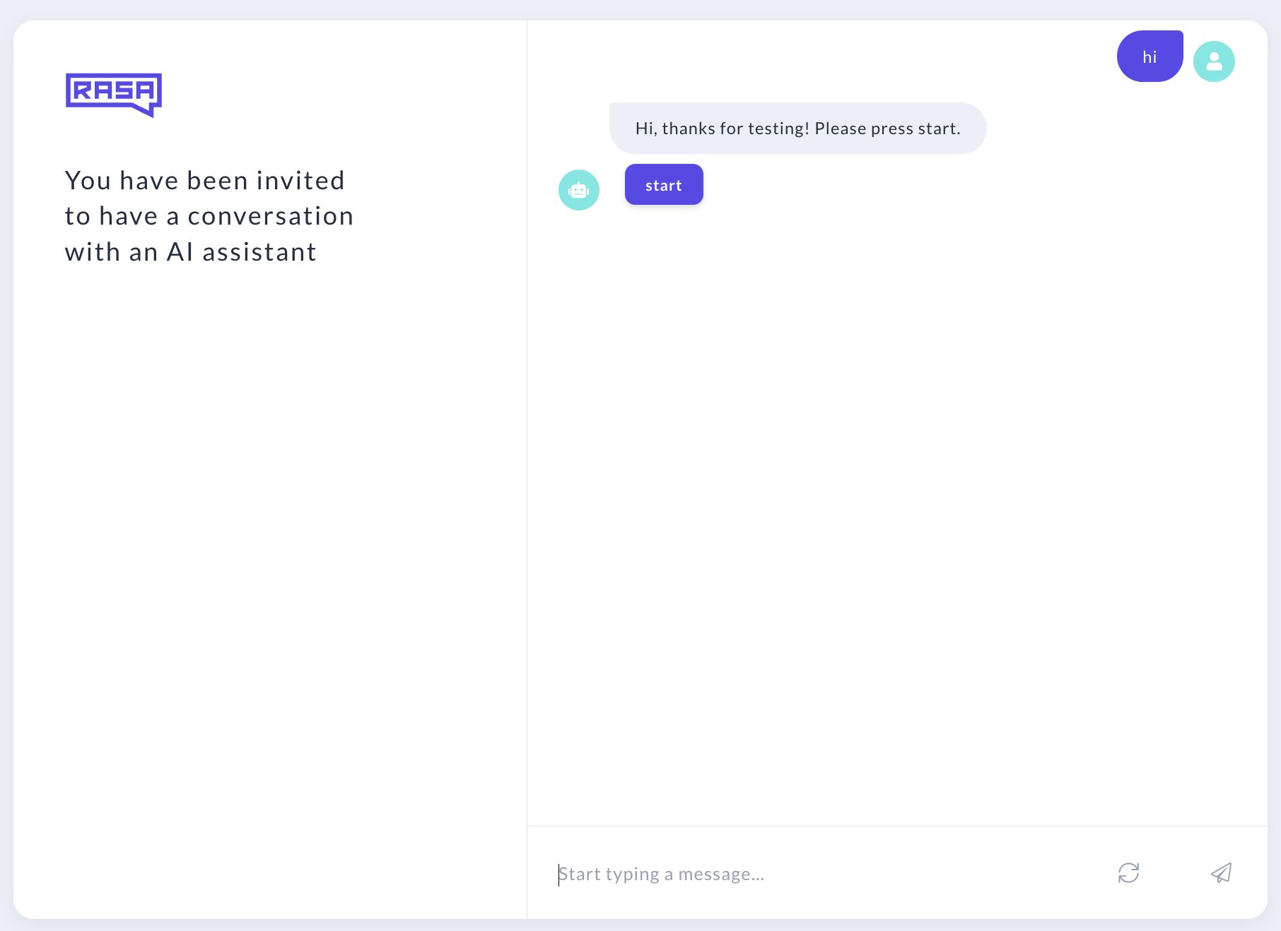
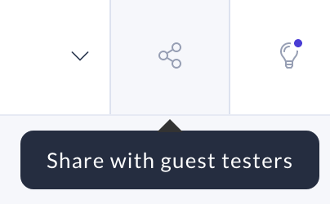
Share your bot with testers using just a link

Slide 145
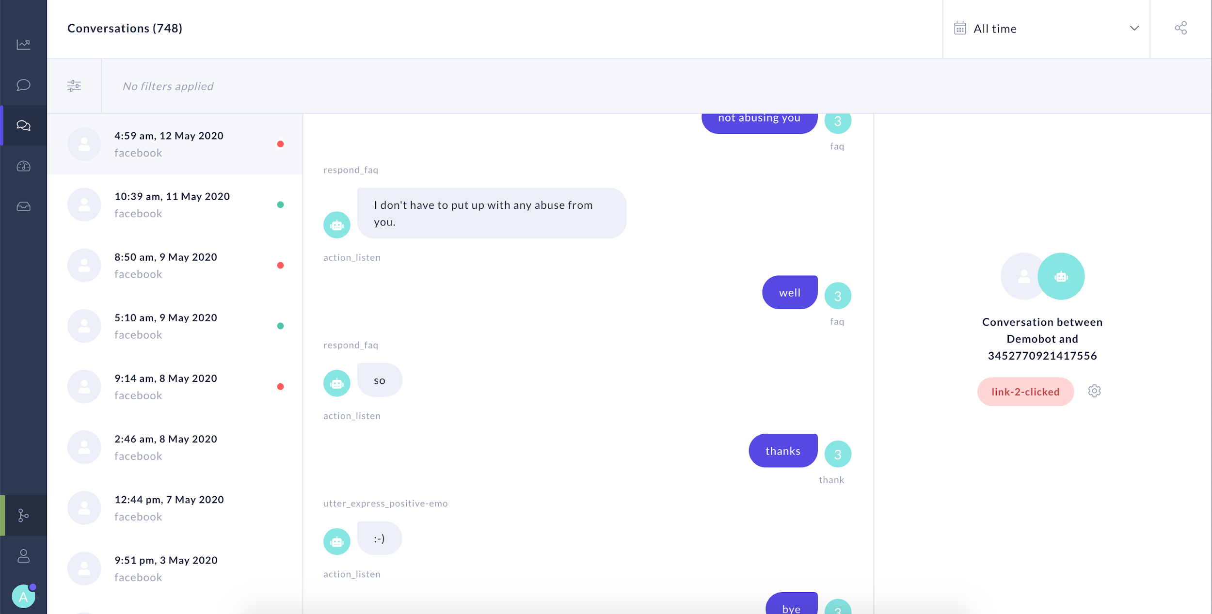
Review conversations coming in from every channel

Slide 146
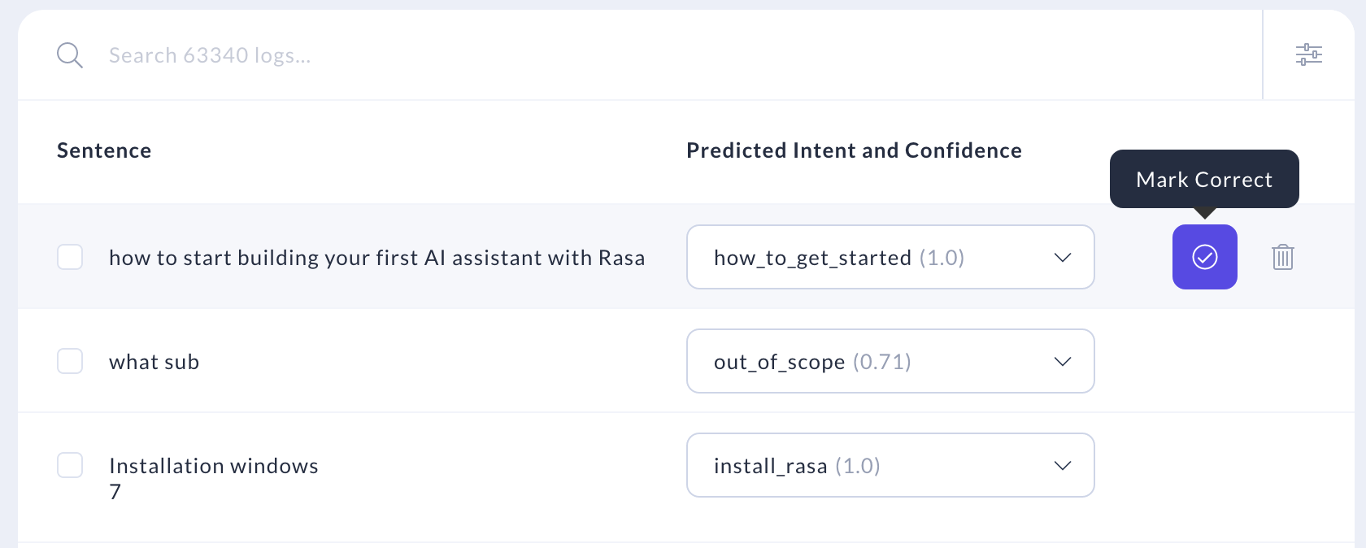
Annotate the messages coming in

Slide 147


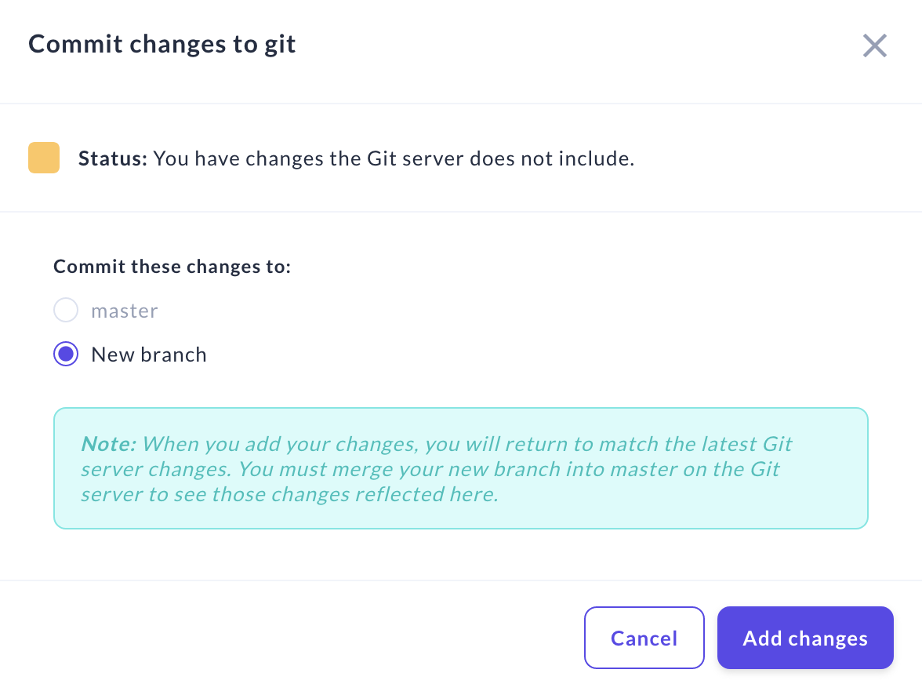
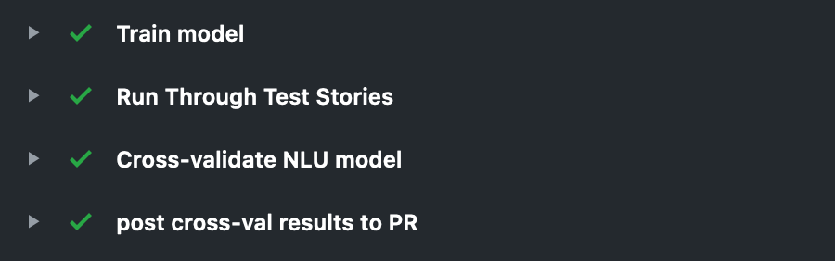
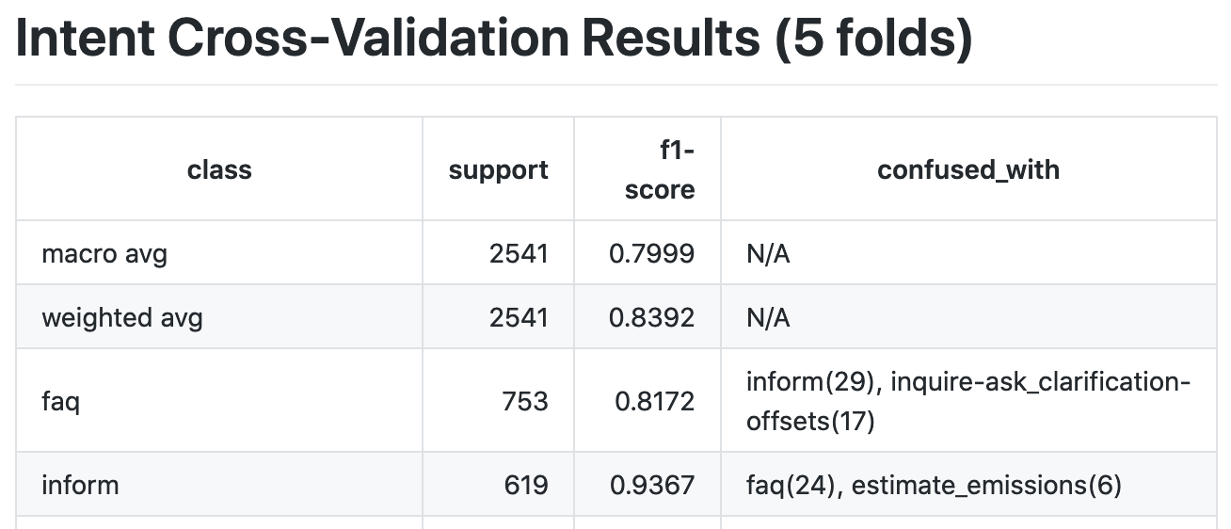
Push new training data to git and trigger your CI pipeline
#232a2e

Slide 148
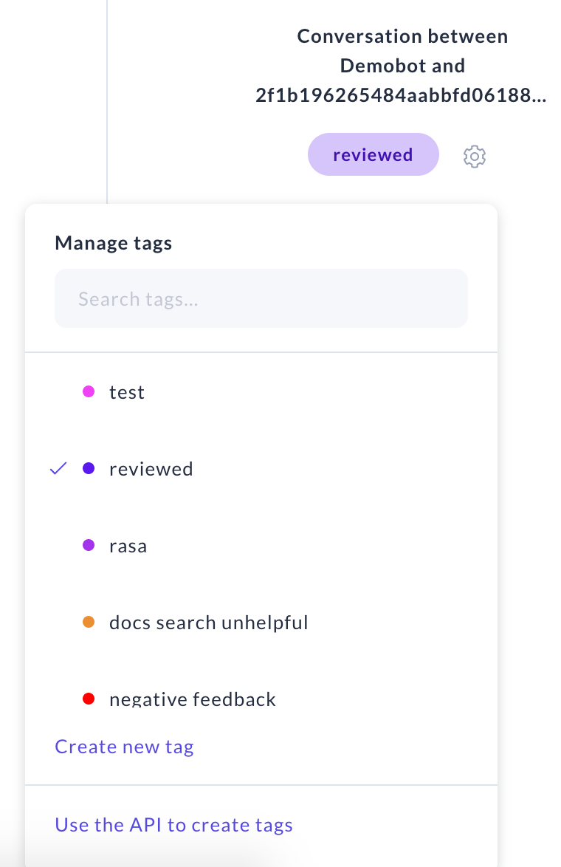
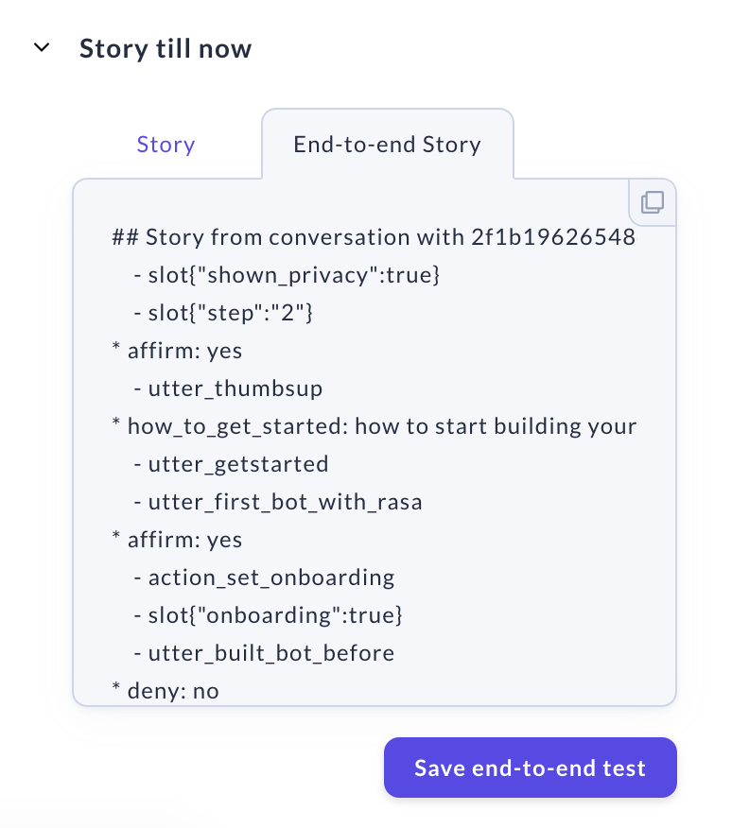
Track failures and successes
Use the API to automatically tag conversations, or add tags manually as you read
Turn successful conversations into new end-to-end tests

Slide 149
Installing Rasa X Locally
Checkout the master branch
git checkout master
Install Rasa X in your virtual environment:
pip3 install rasa-x --extra-index-url https://pypi.rasa.com/simple
Launch Rasa X in the browser by running the following command in your project directory:
rasa x

Slide 150
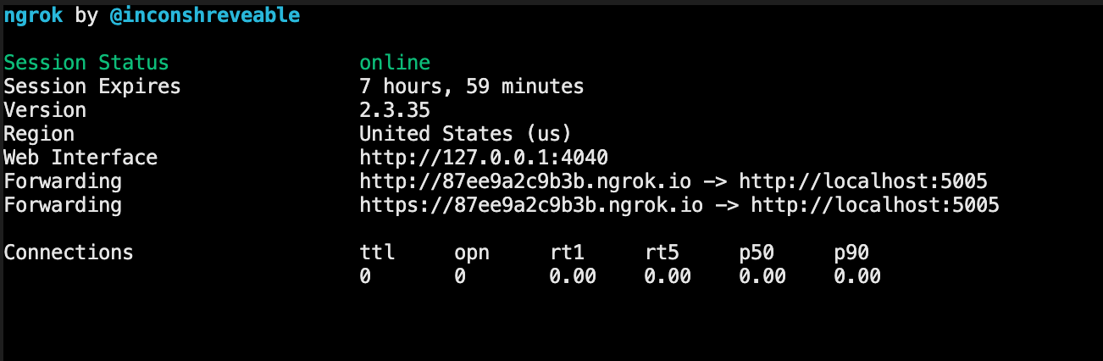
Testing Locally: ngrok
Creates a secure, publicly accessible tunnel URL connected to a process running on localhost.
Allows you to develop as though your application were running on a server instead of locally.

Slide 151
Starting ngrok
Start Rasa X. When you start Rasa X locally, it runs on localhost:5002
Open a new terminal window and start ngrok. Specify that ngrok should listen for the process running on port 5002
ngrok http 5002
Save the URL generated by ngrok
Generate a Share your Bot link in Rasa X.
In the Share Your Bot URL, replace localhost:5002 with your ngrok URL http://92099d45e813.ngrok.io/guest/conversations/production/76a25a7880ac40f5bda7b42d650bca75

Slide 152
Messaging Channels

Slide 153
RASA OPEN SOURCE
Rasa Open Source
Natural Language Understanding
“I want to change my address”
Backend,
database, API, etc.
Message Channels
E.g. Live Chat, App, Messenger
ML-based Dialogue Management
“What’s your new address?”
Response Selection

Slide 154
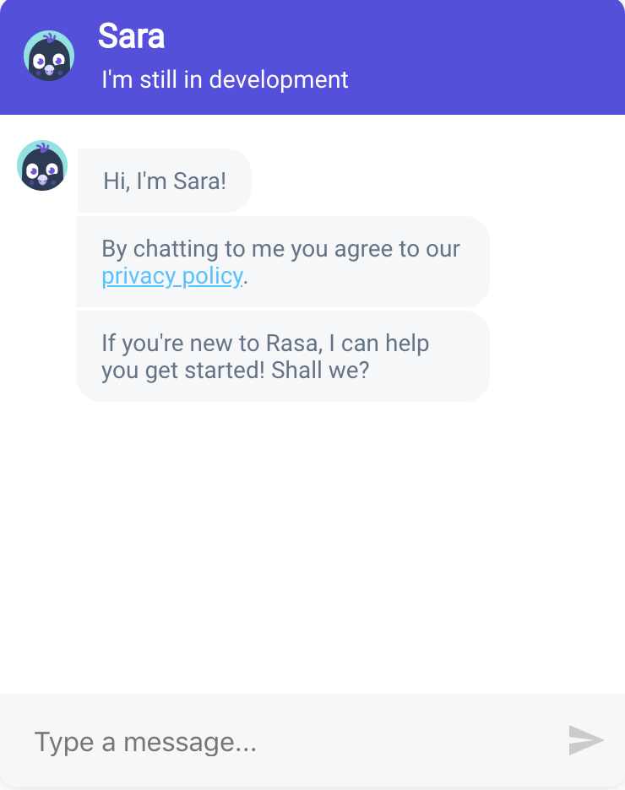





MESSAGING CHANNELS
Built in Channels
Telegram

Slide 155
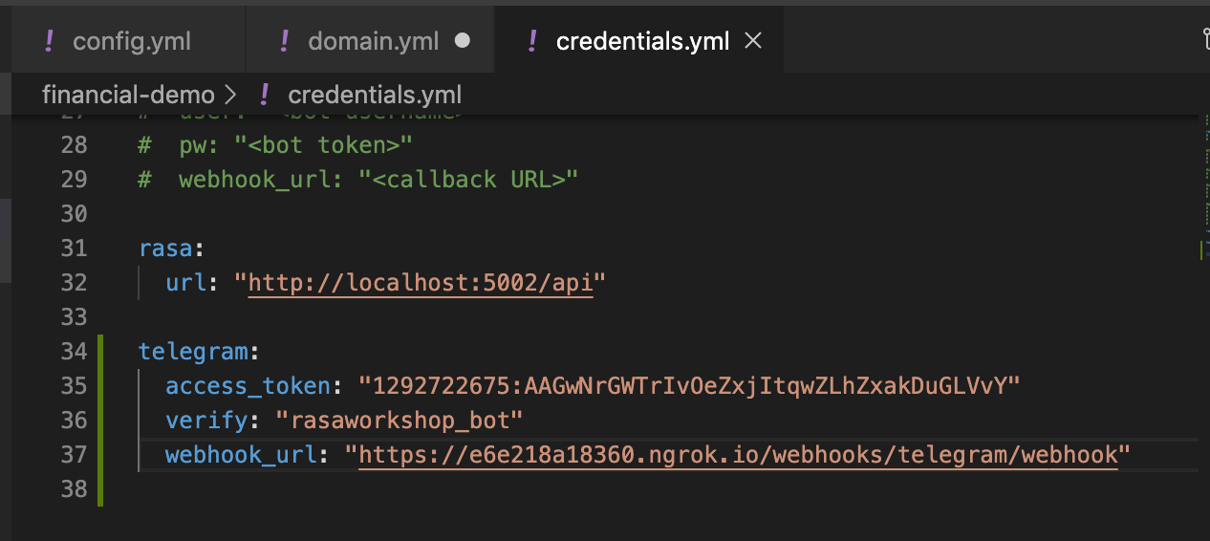
Messaging Channels
Channel connection details are kept in the credentials.yml file
When you move to production, you’ll want to re-create these credentials securely on your server
After you update credentials.yml, start (or restart) the server with rasa run

Slide 156

Telegram
Register a new bot:
Go to https://web.telegram.org/#/im?p=@BotFather
Type /newbot
Name shows up next to the bot’s profile icon
Username is the bot’s handle, and ends in _bot
credentials.yml
Telegram: access_token: "your API token" verify: "bot’s username (ends in _bot)" webhook_url: "https://<ngrok-url>/webhooks/telegram/webhook"

Slide 157
Testing Telegram locally
Start the rasa server (this command starts the server without a chat session on the command line)
rasa run
Start ngrok on port 5005
ngrok http 5005
Add the ngrok URL to your Telegram webhook URL - save the file
Restart the Rasa server (so changes to credentials.yml get picked up)
/stop
rasa run
Make sure your action server is running!
Try talking to your bot on Telegram

Slide 158
What’s Next?

Slide 159

NEXT STEPS
Get people to chat with your assistant and keep improving it!
Where to go from here?
Look at conversations and ask: how does your assistant struggle?
Learn how to solve problem from Rasa Docs and Community Forum
Improve assistant
Test and deploy your update
Repeat 😎

Slide 160
THE APPROACH
Continually improve your assistant using Rasa X
Ensure your new assistant passes tests using continuous integration (CI) and redeploy it to users using continuous deployment (CD)
Collect conversations between users and your assistant
Review conversations and improve your assistant based on what you learn

Slide 161
THE APPROACH
The path to a contextual assistant
No iterations
Quality of assistant
Rasa Open Source (Local)
Rasa X (Server)

Slide 162
THE APPROACH
The path to a contextual assistant
Quality of assistant
Rasa Open Source (Local)
Rasa X (Server)

Slide 163
THE APPROACH
The path to a contextual assistant
Quality of assistant
Rasa Open Source (Local)
Rasa X (Server)

Slide 164
THE APPROACH
The path to a contextual assistant
Quality of assistant
Rasa Open Source (Local)
Rasa X (Server)

Slide 165
THE APPROACH
The path to a contextual assistant
Quality of assistant
Rasa Open Source (Local)
Rasa X (Server)

Slide 166
THE APPROACH
The path to a contextual assistant
Quality of assistant
Rasa Open Source (Local)
Rasa X (Server)

Slide 167
THE APPROACH
The path to a contextual assistant
Quality of assistant
Rasa Open Source (Local)
Rasa X (Server)

Slide 168
THE APPROACH
The path to a contextual assistant
Quality of assistant
Rasa Open Source (Local)
Rasa X (Server)

Slide 169
THE APPROACH
The path to a contextual assistant
A few iterations
Quality of assistant
Rasa Open Source (Local)
Rasa X (Server)

Slide 170
THE APPROACH
The path to a contextual assistant
Quality of assistant
Rasa Open Source (Local)
Rasa X (Server)

Slide 171
THE APPROACH
The path to a contextual assistant
Quality of assistant
Rasa Open Source (Local)
Rasa X (Server)

Slide 172
THE APPROACH
The path to a contextual assistant
Quality of assistant
Rasa Open Source (Local)
Rasa X (Server)

Slide 173
THE APPROACH
The path to a contextual assistant
Quality of assistant
Rasa Open Source (Local)
Rasa X (Server)

Slide 174
THE APPROACH
The path to a contextual assistant
Quality of assistant
Rasa Open Source (Local)
Rasa X (Server)

Slide 175
THE APPROACH
The path to a contextual assistant
Quality of assistant
Rasa Open Source (Local)
Rasa X (Server)

Slide 176
THE APPROACH
The path to a contextual assistant
Many iterations
Quality of assistant
Rasa Open Source (Local)
Rasa X (Server)

Slide 177
THE APPROACH
The path to a contextual assistant
Quality of assistant
Rasa Open Source (Local)
Rasa X (Server)

Slide 178
THE APPROACH
The path to a contextual assistant
Quality of assistant
Rasa Open Source (Local)
Rasa X (Server)

Slide 179
THE APPROACH
The path to a contextual assistant
Quality of assistant
Rasa Open Source (Local)
Rasa X (Server)

Slide 180
THE APPROACH
The path to a contextual assistant
Quality of assistant
Rasa Open Source (Local)
Rasa X (Server)

Slide 181
THE APPROACH
The path to a contextual assistant
A lot of iterations
Quality of assistant
Rasa Open Source (Local)
Rasa X (Server)

Slide 182
Build a minimum viable assistant with Rasa Open Source + improve it using Rasa X
Build minimum viable assistant
Improve by talking to the assistant
Improve using conversations with test users
Improve using conversations with real users
Talk to your bot
Quality of assistant
Rasa Open Source is an open source framework for natural language understanding, dialogue management, and integrations.
Rasa Open Source (Local)
Rasa X is a toolset used to improve a contextual assistant built using Rasa Open Source.
Rasa X (Server)

Slide 183
Build a minimum viable assistant with Rasa Open Source + improve it using Rasa X
Share your bot
Build minimum viable assistant
Improve by talking to the assistant
Improve using conversations with test users
Improve using conversations with real users
Quality of assistant
Rasa Open Source is an open source framework for natural language understanding, dialogue management, and integrations.
Rasa Open Source (Local)
Rasa X is a toolset used to improve a contextual assistant built using Rasa Open Source.
Rasa X (Server)

Slide 184
Build a minimum viable assistant with Rasa Open Source + improve it using Rasa X
Build minimum viable assistant
Improve by talking to the assistant
Improve using conversations with test users
Improve using conversations with real users
Real users on Telegram
Quality of assistant
Rasa Open Source is an open source framework for natural language understanding, dialogue management, and integrations.
Rasa Open Source (Local)
Rasa X is a toolset used to improve a contextual assistant built using Rasa Open Source.
Rasa X (Server)

Slide 185

DEVELOPMENT WORKFLOW
End-to-end workflow for managing assistant updates

Slide 186
Recap

Slide 187
RECAP
What we’ve learned so far
Set up
Deep dive of NLU and dialogue management
Build an MVP assistant
Share your assistant with the outside world
Make iterative improvements and take your assistant to the next level

Slide 188
RASA OPEN SOURCE
Rasa Open Source
Natural Language Understanding
“How much did I spend at Starbucks last week?”
Backend,
database, API, etc.
Connector Modules
E.g. Live Chat, App, Messenger
ML-based Dialogue Management
“You spent $12 at Starbucks!”
Response Selection

Slide 189
NLU Deep Dive
Intents and Entities
Two of the most common and necessary types of information to extract from a message
Intent: What the user wants to achieve
How much did I spend at Starbucks last week?
Entity: Key piece of information

Slide 190
Dialogue Management Deep Dive: Policies
Policies
Decide which action to take at every step in the conversation
Each policy predicts an action with some probability. This is called core confidence.
Interpreter
“I want to know how much I spent at Starbucks last week”
1
2
Message In
Tracker
3
Policy
Message Out
“You spent $12 at Starbucks”
6
5
Action
4

Slide 191
Core Deep Dive
Domain
Defines the “world” of your assistant - what it knows, can understand, and can do
intents:
…
entities:
…
slots:
…
actions:
…
responses:
…
session_config:
…
What your bot can understand
What your bot can remember
What your bot can do (and say)
What your bot can say (and display)
What your bot considers a new conversation

Slide 192
Core Deep Dive: Policies
Multiple Policies
The policy with the highest confidence wins.
If the confidence of two policies is equal, the policy with the highest priority wins.
Policy priorities
(higher numbers = higher priority)
5. FormPolicy
4. FallbackPolicy, TwoStageFallbackPolicy
3. MemoizationPolicy, AugmentedMemoizationPolicy
2. MappingPolicy
1. EmbeddingPolicy, TEDPolicy
Rule-based policies have higher priority than ML-based policies

Slide 193
NLU Deep Dive
DIET is our new neural network architecture for NLU
What is DIET?
New state of the art neural network architecture for NLU
Predicts intents and entities together
Plug and play pretrained language models

Slide 194
We found out that the Transformer Embedding Dialogue policy can untangle sub-dialogues
paper
@madymantha

Slide 195
Conversation Design
Scope Conversation
How to get started with conversation design
The assistant’s purpose
Leverage the knowledge of domain experts
Common search queries
FAQs and wikis

Slide 196
Training Data for NLU and Dialogue Management
Machine learning models require training data that the models can generalize from
NLU needs data in the form of examples for intents
Dialogue management model needs data in the form of stories
## intent:bot_challenge
- are you a bot?
- are you a human?
- am I talking to a bot?
- am I talking to a human?
## intent:i_like_food
- I like [apples](food)
- my friend likes [oranges](food)
- I'm a fan of [pears](food)
- do you like [coffee](food)
## new to rasa at start
* how_to_get_started{"user_type": "new"}
- action_set_onboarding
- slot{"onboarding": true}
- utter_getstarted_new
- utter_built_bot_before
* deny
- utter_explain_rasa_components
- utter_rasa_components_details
- utter_ask_explain_nlucorex

Slide 197
LIVE CODING: MINIMUM VIABLE ASSISTANT
What is a Minimum Viable Assistant (MVA)?
A basic assistant that can handle the most important happy path stories.
Happy path: If your assistant asks a user for some information and the user provides it, we call that a happy path.
Unhappy path: All the possible edge cases of the bot

Slide 198
Testing
Use the Rasa CLI to test your assistant
End to End Evaluation
NLU Evaluation
Core Evaluation
Run through test conversations to make sure that both NLU and Core make correct predictions.
Split data into a test set or estimate how well your model generalizes using cross-validation.
Evaluate your trained model on a set of test stories and generate a confusion matrix.
$ rasa test
$ rasa test nlu -u data/nlu.md --config config.yml --cross-validation
$ rasa test core --stories test_stories.md --out results

Slide 199
Core Deep Dive
Custom Actions: Connecting to the outside world
Natural Language Understanding
My new address is 222 Broadway NYC.
Backend,
database, API, etc.
Connector Modules
ML-based Dialogue Management
~~~
Natural Language Generation

Slide 200
Core Deep Dive
Events
Internally, all conversations are represented as a sequence of events.
Some events are automatically tracked
Events
Story
UserUttered
SlotSet
SlotSet
BotUttered
UserUttered
Restarted
## new to rasa at start
* how_to_get_started{"user_type": "new"}
- action_set_onboarding
- slot{"onboarding": true}
- utter_getstarted_new
* restart
- action_restart

Slide 201
Core Deep Dive
Tracker
Trackers maintain the state of a dialogue between the assistant and the user.
It keeps track of events, slots, session info etc.
{
"sender_id": "default",
"slots": {
"user_type": "new",
"onboarding": true},
"latest_message": {...},
"events": [
...
{"event": "action",
"name": "action_set_onboarding",
"policy": "MemoizationPolicy",
"confidence": 0.92},
...
{"event": "user",
"text": "\/restart",...},
...
]
}
Session info
Slots
Events:
...
SlotSet
...
UserUttered
...

Slide 202
Core Deep Dive
Slots
Your bot’s memory
Can store:
user-provided info
info from the outside world
Can be set by:
NLU (from extracted entities, or buttons)
Custom Actions
Can be configured to affect or not affect the dialogue progression

Slide 203
Core Deep Dive
Actions
Things your bot runs in response to user input.
Four different action types:
Utterance actions: `utter_`
send a specific message to the user
specified in `responses` section of the domain
Retrieval actions: `respond_`
send a message selected by a retrieval model
Custom actions: `action_`
run arbitrary code and send any number of messages (or none).
return events
Default actions:
built-in implementations available but can be overridden
E.g. action_listen, action_restart, action_default_fallback

Slide 204
Core Deep Dive
Custom Actions: Examples
Custom actions can do whatever you want them to! e.g.
Send multiple messages
Query a database
Make an API call to another service
Return events e.g.
Set a slot
e.g. based on a database query)
Force a follow up action
force a specific action to be executed next
Revert a user utterance
I.e. remove a user utterance from the tracker

Slide 205
Core Deep Dive
Forms
The structure of the form
## pay credit card happy path
* greet
- utter_greet
* pay_cc
- cc_payment_form
- form{"name": "cc_payment_form"}
- form{"name": null}
User input
Form action
Form activated
Form deactivated

Slide 206
Core Deep Dive
Forms
Handling unhappy paths
Users are not always cooperative - they can change their mind or interrupt the form.
Use action action_deactivate_form to handle the situation where users decide not to proceed with the form:
## chitchat
* request_restaurant
- restaurant_form
- form{"name": "restaurant_form"}
* stop
- utter_ask_continue
* deny
- action_deactivate_form
- form{"name": null}

Slide 207
Rasa X Tour
Rasa X turns conversations into training data
Review Conversations
See what users are saying to your bot
Manage Training Data
Annotate training data and add new examples
🤖
💬
Messaging channels
Share your bot
Conversations
Rasa X
Conversations
Review 👁️‍🗨️ Annotate ✏️ Improve 💪

Slide 208
Rasa X Tour
Real Conversations > Synthetic Data
During development, training data is created by:
Writing down hypothetical conversations and training examples
Studying existing chat transcripts or knowledge bases
Consulting subject matter experts
That’s a great start, but all of those scenarios are based on human:human conversations.
Human:bot conversations have different patterns - users say different things when they are talking to a bot.
The best training data is generated from the assistant’s actual conversations

Slide 209
Conversation-Driven Development
Share
Review
Annotate
Test
Track
Fix
1
2
3
4
5
6

Slide 210
Build a minimum viable assistant with Rasa Open Source + improve it using Rasa X
Build minimum viable assistant
Improve by talking to the assistant
Improve using conversations with test users
Improve using conversations with real users
Talk to your bot
Quality of assistant
Rasa Open Source is an open source framework for natural language understanding, dialogue management, and integrations.
Rasa Open Source (Local)
Rasa X is a toolset used to improve a contextual assistant built using Rasa Open Source.
Rasa X (Server)

Slide 211
Build a minimum viable assistant with Rasa Open Source + improve it using Rasa X
Build minimum viable assistant
Improve by talking to the assistant
Improve using conversations with test users
Improve using conversations with real users
Share your bot
Quality of assistant
Rasa Open Source is an open source framework for natural language understanding, dialogue management, and integrations.
Rasa Open Source (Local)
Rasa X is a toolset used to improve a contextual assistant built using Rasa Open Source.
Rasa X (Server)

Slide 212
Build a minimum viable assistant with Rasa Open Source + improve it using Rasa X
Build minimum viable assistant
Improve by talking to the assistant
Improve using conversations with test users
Improve using conversations with real users
Real users
Quality of assistant
Rasa Open Source is an open source framework for natural language understanding, dialogue management, and integrations.
Rasa Open Source (Local)
Rasa X is a toolset used to improve a contextual assistant built using Rasa Open Source.
Rasa X (Server)

Slide 213
DEVELOPMENT WORKFLOW
End-to-end workflow for managing assistant updates

Slide 214

DEVELOPMENT WORKFLOW
How Rasa fits into your stack

Slide 215

DEVELOPMENT WORKFLOW
How Rasa fits into your stack

